Slide 1
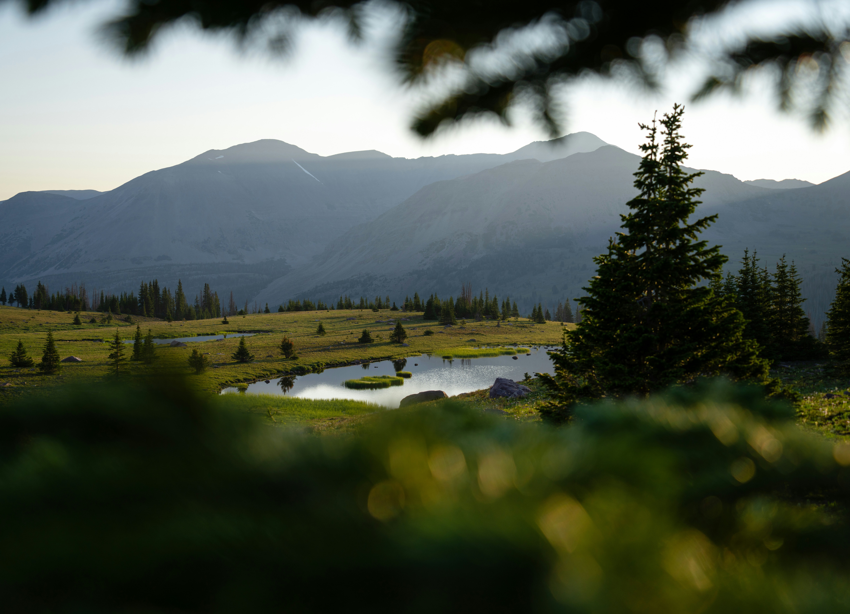
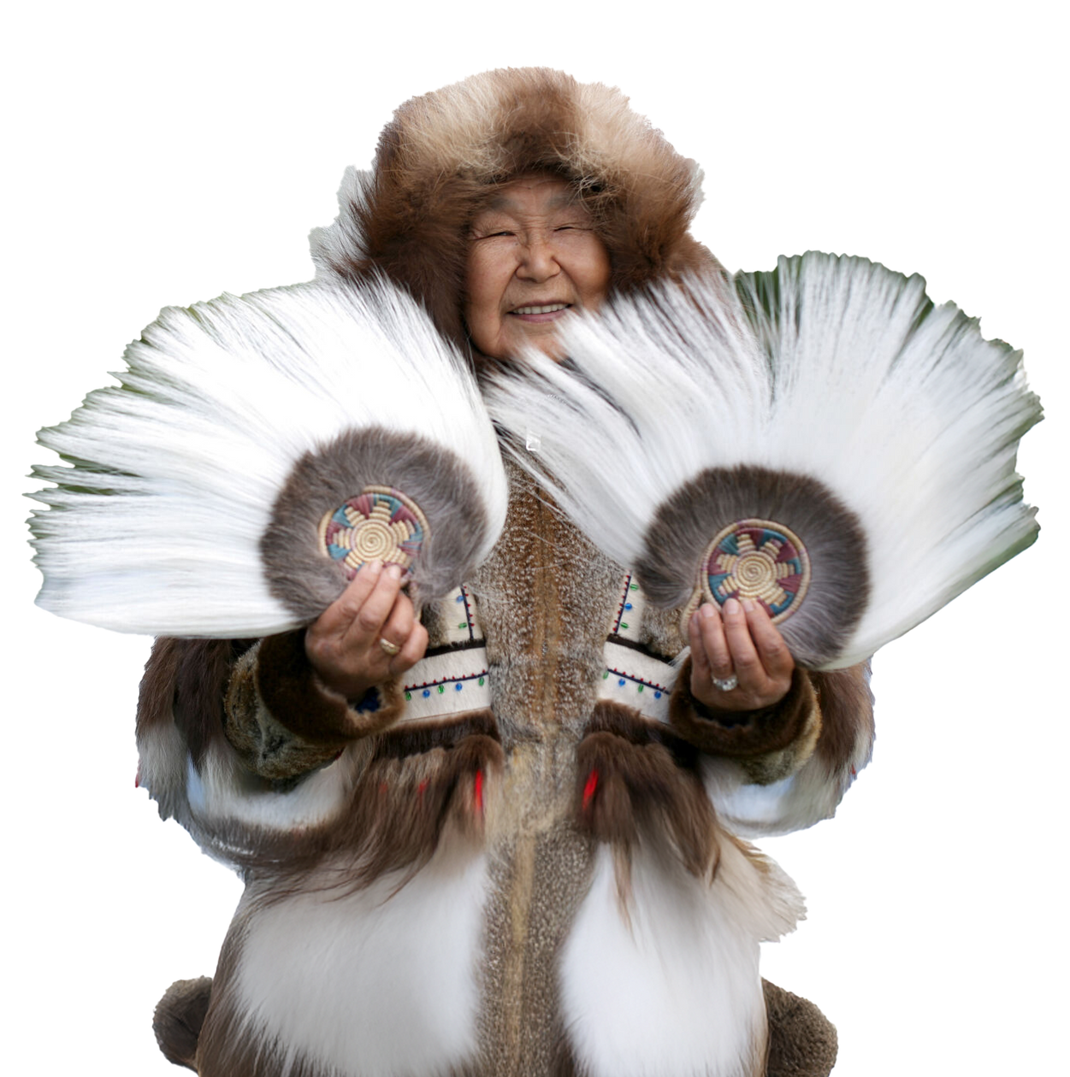




SUPPORTING TOURISM AND HEALTHY LANDS IN NATIVE NATIONS AND COMMUNITIES.
Notes:
START WEBINAR RECORDING and give it a couple of minutes for people to join in.

Slide 2

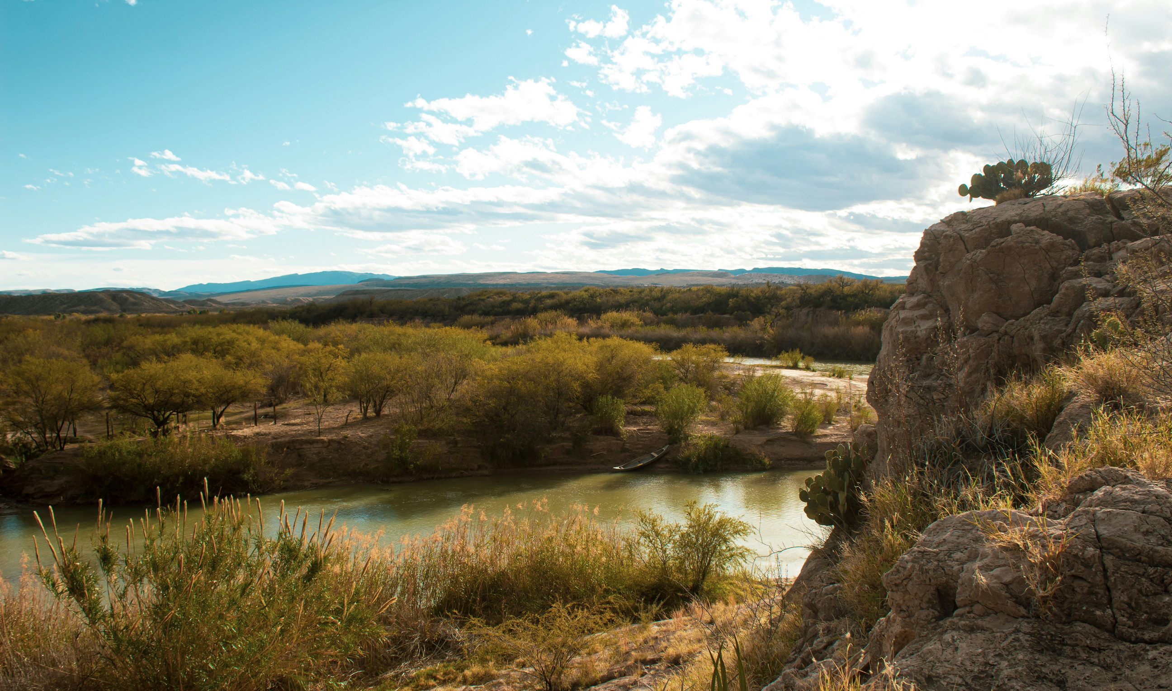
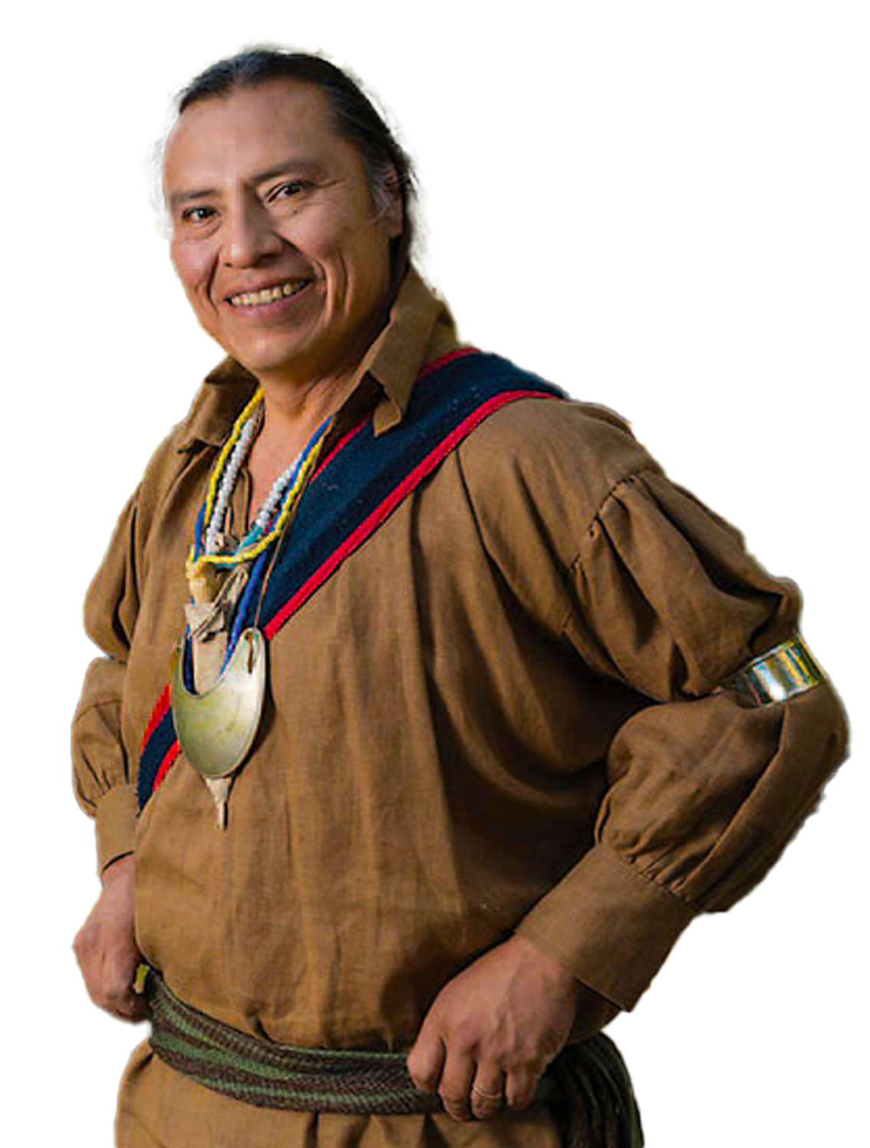


PROTECTING NIGHT SKIES AND ECONOMIC BENEFITS: INCORPORATING DARK SKY PROGRAMMING IN SUPPORT OF YOUR RECREATION AND LAND USE PLANS
NOVEMBER 18, 2025
10 AM MDT
Notes:
Moderator: Good morning, all. Thank you for joining us today for AIANTA’s Webinar Series. Today’s webinar is in partnership with partners/funding source.
Moderator: I am Moderator Name, Title (introduce yourself).
For more than 25 years, the American Indian Alaska Native Tourism Association (AIANTA) has served as the only national organization dedicated to advancing cultural heritage tourism in Native Nations and communities across the United States. Established by tribes for tribes to address inequities in the tourism system, AIANTA is a 501(c)(3) national nonprofit governed by an all-Native board of directors and serves as a united voice for the $15.7 billion Native hospitality sector. AIANTA’s mission is to define, introduce, grow, and sustain American Indian, Alaska Native and Native Hawaiian (AIANNH) tourism that honors traditions and values while helping AIANNH businesses become market/export ready for domestic and international markets. Tribes who are looking to start or expand their cultural tourism footprint can find resources at www.aianta.org and visitors interested in learning more about Native culture can visit www.nativeamerica.travel.
This presentation will cover webinar description (1-2 sentences).
Today, our presenters will be…

Slide 3

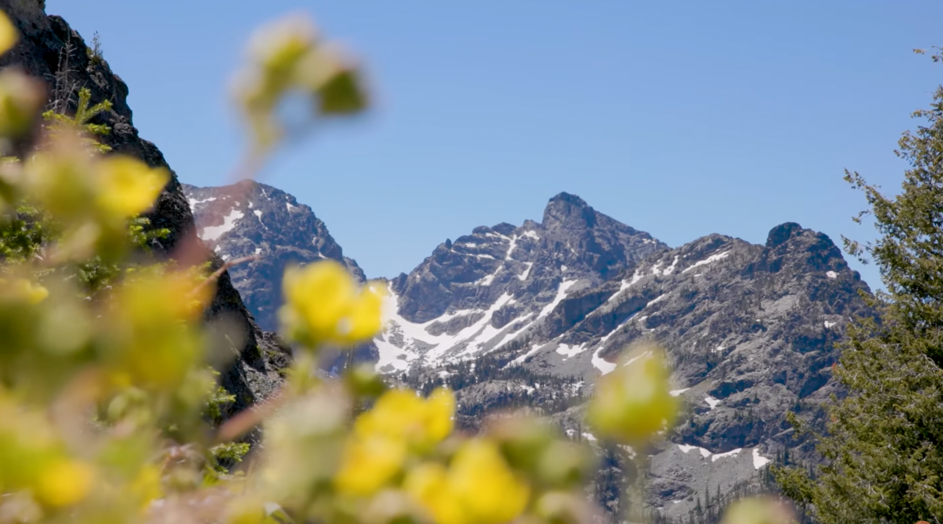
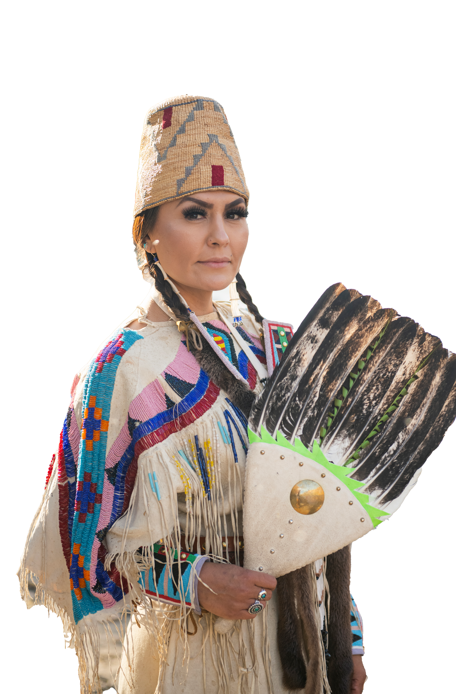

ABOUT US
27+ years as the only national organization dedicated to advancing cultural heritage tourism in Native Nations and communities.
Established by tribes for tribes to address tourism system inequities.
501(c)(3) nonprofit governed by an all-Indigenous board of directors.
Serves as a unified voice for the $11.6 billion Native hospitality sector.
Led the passage and funding of the NATIVE Act (2018), securing support for American Indigenous Tourism.
Mission: To define, introduce, grow, and sustain American Indigenous tourism that honors traditions and values.
Resources for Tribes: www.AmericanIndigenousTourism.com
Travel Inspiration: www.DestinationNativeAmerica.com
Notes:
Moderator: For more than 25 years, the American Indian Alaska Native Tourism Association (AIANTA) has served as the only national organization dedicated to advancing cultural heritage tourism in Native Nations and communities across the United States. Established by tribes for tribes to address inequities in the tourism system, AIANTA is a 501(c)(3) national nonprofit governed by an all-Native board of directors and serves as a united voice for the $15.7 billion Native hospitality sector. AIANTA’s mission is to define, introduce, grow, and sustain American Indian, Alaska Native and Native Hawaiian (AIANNH) tourism that honors traditions and values while helping AIANNH businesses become market/export ready for domestic and international markets. Tribes who are looking to start or expand their cultural tourism footprint can find resources at www.aianta.org and visitors interested in learning more about Native culture can visit www.nativeamerica.travel.
This presentation will cover webinar description (1-2 sentences).
Today, our presenters will be…

Slide 4
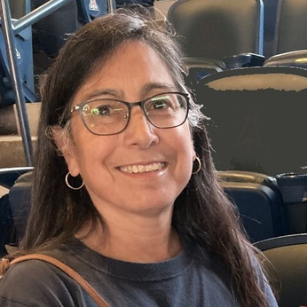
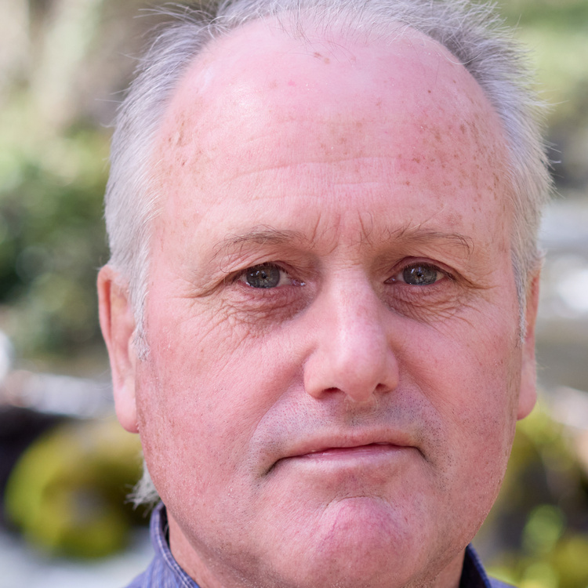

PROTECTING NIGHT SKIES AND ECONOMIC BENEFITS: INCORPORATING DARK SKY PROGRAMMING IN SUPPORT OF YOUR RECREATION AND LAND USE PLANS
SUPPORTING CLIMATE RESILIENCE, TOURISM, AND HEALTHY LANDS IN NATIVE NATIONS AND COMMUNITIES
GINA PEARSON
BOB HACKETT
COLLEEN COLEMAN
PLANNING & ENVIRONMENTAL COORDINATOR, BUREAU OF LAND MANAGEMENT TAOS FIELD OFFICE
EXECUTIVE DIRECTOR,
TRAVEL SOUTHERN OREGON
COMMUNITY NAVIGATOR PROJECT DIRECTOR, AMERICAN INDIGENOUS TOURISM ASSOCIATION
NOVEMBER 18, 2025 @ 10 AM MST
REGISTER: http://bit.ly/CNP-25WebinarNOV18
Notes:
Slide 4 – Speaker Introductions – Headshots
Moderator: Our first presenter is Speaker – Title – Bio.
Our next speaker is Speaker – Title – Bio.
We also have with us today, Speaker – Title – Bio.
I will now pass it over to our presenters; If you have any questions, please place them in the chat or the Q&A and we’ll get to them at the end of the presentation.

Slide 5
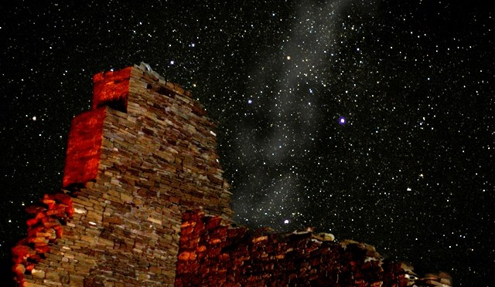
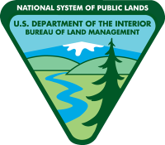
Protecting Night Skies and Economic Benefits
Gina Pearson
Bureau of Land Management
Taos Field Office, New Mexico
Notes:
Photos nps.gov

Slide 6
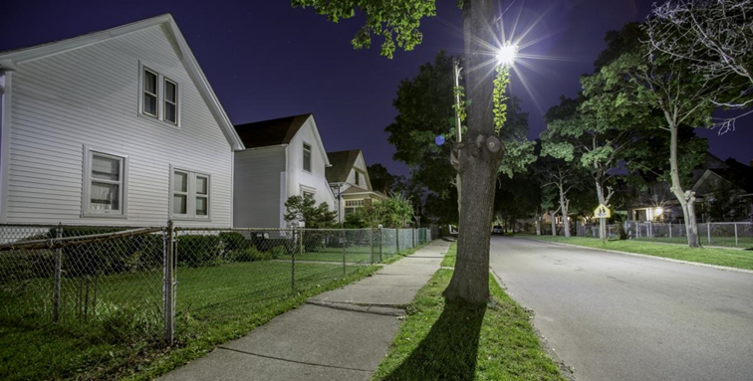
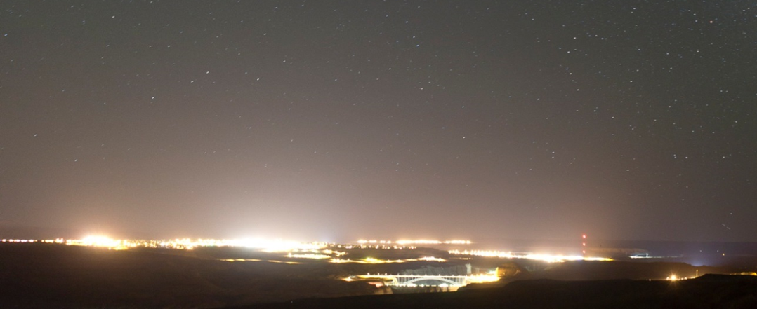
Light Pollution: What is it and Why Should We Care?
Light pollution is excessive, misdirected, or obtrusive artificial (human-made) light.
Notes:
Fact Sheets on Light Pollution – DSI - https://darksky.org/resources/public-outreach-materials/
Light Trespass: Unwanted light that spills over into areas where it is not needed, such as neighboring properties.
Glare: bright light source causes discomfort or interferes with vision. It can cause accidents on roads from blue LED lights and affect wildlife behavior.
Skyglow: brightening of the sky over a populated area. It is caused by the scattering of light in the atmosphere due to the presence of pollutants and dust particles. Skyglow is the most common type of light pollution.
Clutter: excessive grouping of lighting fixtures that create unnecessary and unwanted light

Slide 7
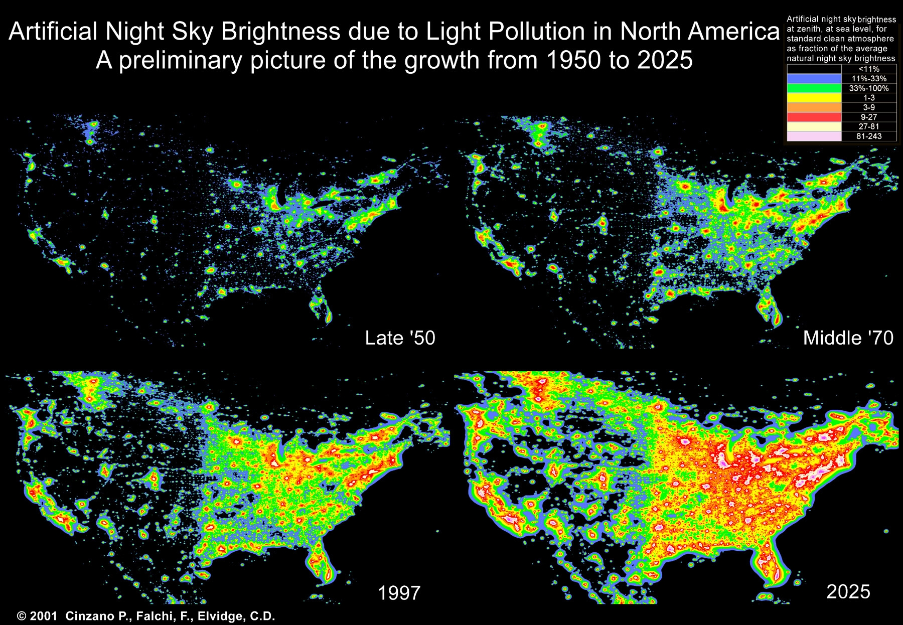
Artificial Night Sky Brightness due to Light Pollution
Cinzano, Falchi, and Elvidge 2001
Notes:
Our dark night skies are a threatened resource.
At the turn of the century it was estimated that two-thirds of the US population live where they cannot see the Milky Way (Cinzano, 2001).
Recent citizen scientists’ measurements indicate that the average night sky got brighter by 10% per year from 2011 to 2022, which is equivalent to doubling the sky brightness every 8 years.
The exceptions to this rapid increase in light pollution is in areas where lighting ordinances have been developed and areas certified as dark sky places.

Slide 8
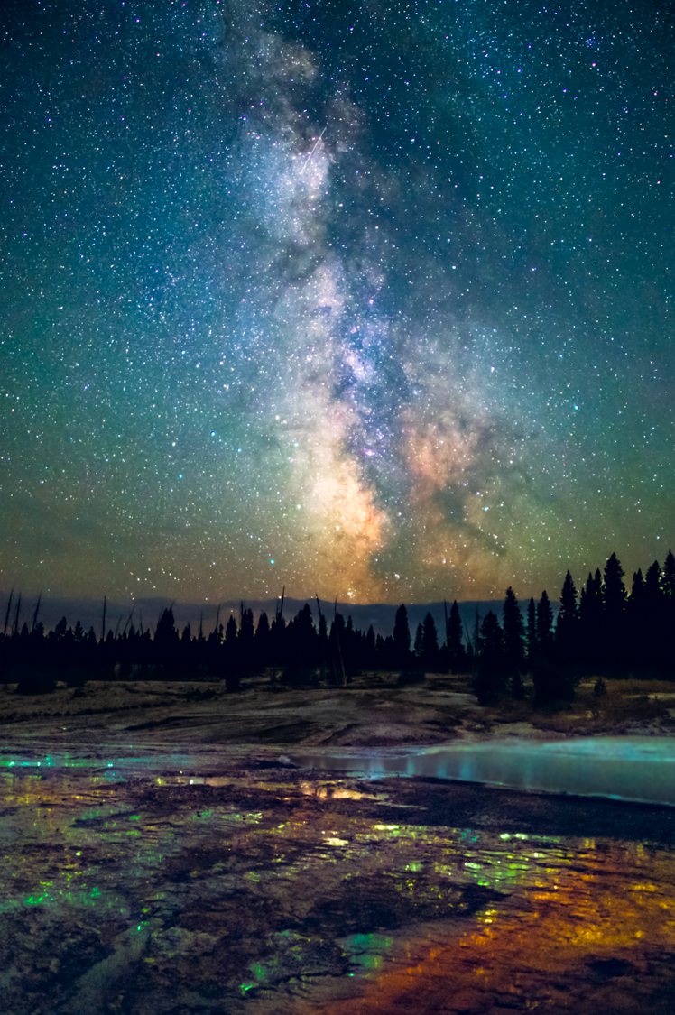
. Night Sky Visibility/Astronomy Research . Human Health & Public Safety . Saves Money – Reduces Energy Usage ($) . Protects Nocturnal Wildlife . Visitor Experience/ Astro-Tourism . Aesthetic/Historical Integrity . Indigenous Cultural Connections
Why is reducing light pollution important?
© Bryony Richards (used with permission)
Notes:
Fact Sheets on Light Pollution – DSI - https://darksky.org/resources/public-outreach-materials/
VALUES
Research has shown that light pollution in residential areas was found to disrupt people’s natural sleep patterns (circadian rhythm) and over time could lead to serious health issues.
Many high-intensity LEDs emit a large amount of blue-bright white light that’s been shown to “decrease visual acuity and safety,” creating hazardous conditions for nighttime driving.
Quarterly Connections Presentation: Crime Prevention Through Environmental Design – Art Hushen Presentation. https://extension.usu.edu/iort/cp-darkskies/files/QC9_Hushen_Presentation.pdf (slide deck). Balancing Outdoor Lighting for Public Safety & Night Sky Protection–5Mar2025 - https://www.youtube.com/watch?v=yuowi0VpSbI
LED outdoor lighting can save the US over $45 million annually, however most outdoor lighting is wasted and only about 1% serves a useful purpose, thus most outdoor light wastes energy.
Dr. Travis Longcore, professor at UCLA, has been studying the effects of light pollution on the ecological environment for over 20 years. https://travislongcore.net/research/light-pollution/. Many other researchers – including impacts on insect populations, bats, and birds.

Slide 9
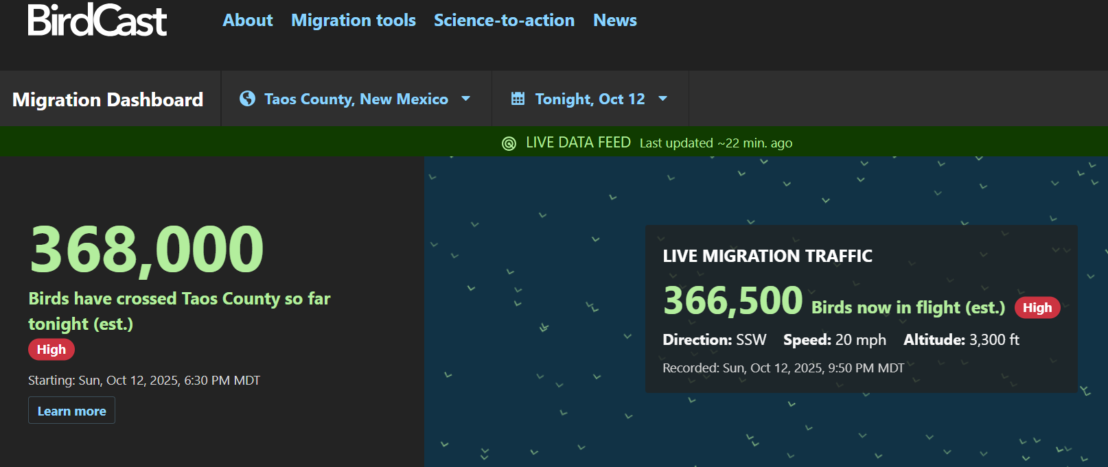
Science to Action
Lights Out for Birds at Night: International Program, including 30 US cities.
Lights out from 11pm – 6am.
Notes:
BirdCast Migration Dashboard: https://dashboard.birdcast.info/region/US-NM-055
Light pollution attracts and disorients migrating birds, confusing and exhausting them as well as making them vulnerable to collisions with buildings, and other urban threats like cats and toxins. An estimated 365 – 988 million birds die in collisions with buildings annually, including species of high conservation concern.

Slide 10
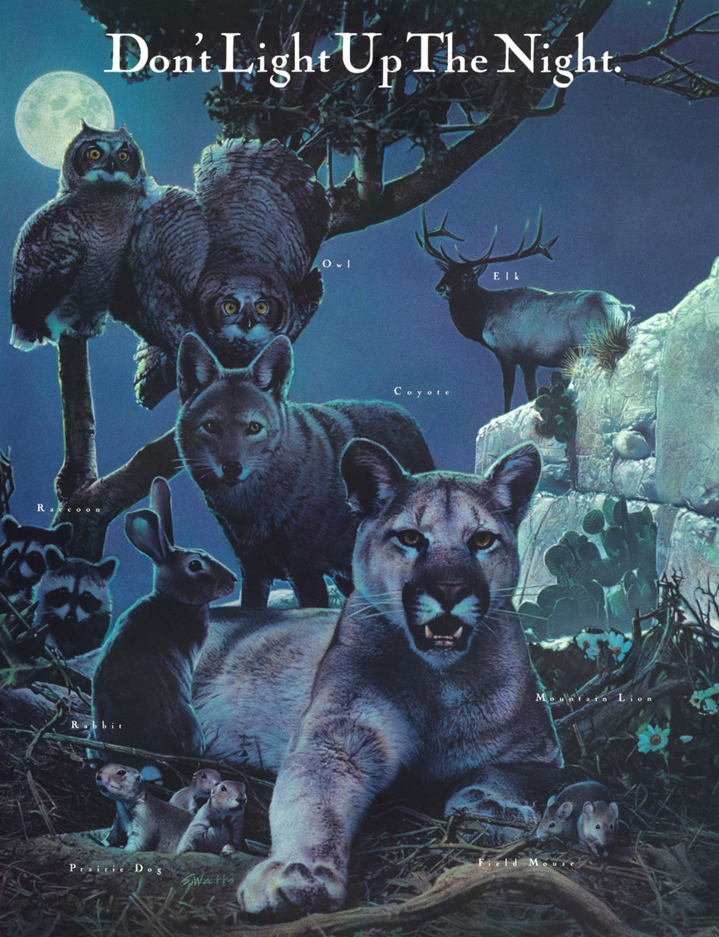
Why is BLM concerned with light pollution and protecting night skies?
BLM mission is to manage public lands “in a manner that will protect the quality of scientific, scenic, historical, ecological, environmental, air and atmosphere values … that where appropriate, will preserve and protect certain public lands in their natural condition ... and provide for outdoor recreation…” FLPMA
BLM lands within the National Conservation Lands Program (monuments, wild & scenic rivers, wilderness, and scenic and historic trails) addresses dark skies: “the BLM will protect the night sky by avoiding light spill and light pollution when designing and installing lighting at facilities within these units” BLM Manual 6100
Notes:
The night sky is not your typical resource such as wildlife, vegetation, soils, water, or air that people think of protecting. However, the night sky does have scientific, scenic, historical/cultural and ecological values that should be protected and which we should provide outdoor recreation opportunities for those same values.
FLPMA – Federal Land Policy and Management Act, BLM’s enabling legislation

Slide 11
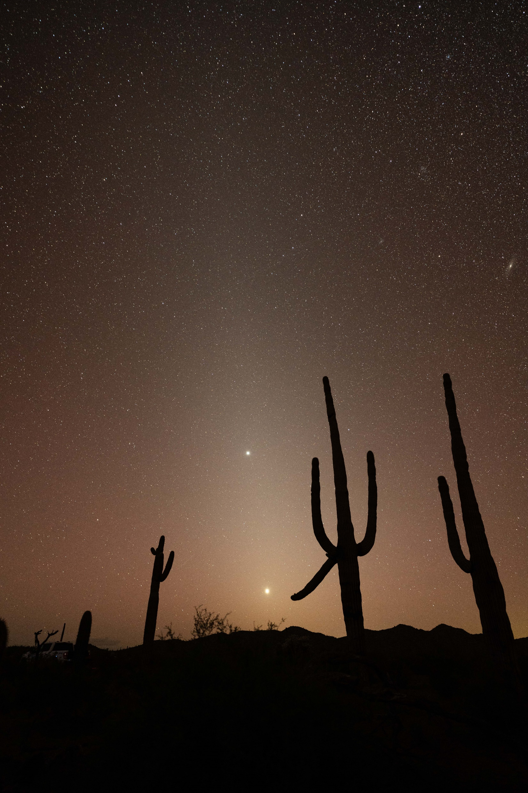
Notes:
https://www.blm.gov/sites/default/files/docs/2023-04/Library_BLMTechnicalNote457_final.pdf

Slide 12
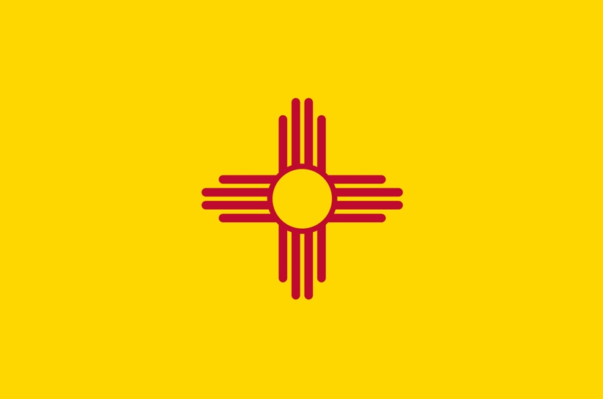
State of New Mexico
Night Sky Protection Act, 1999
Purpose:
“to regulate outdoor night lighting fixtures to preserve and enhance the state’s dark sky while promoting safety, conserving energy and preserving the environment for astronomy.”
One of the first of its kind in the US
Made dark skies a priority for the health of its people, wildlife, and economy
Needs updating to address LED lights and ROLAN
Notes:
2006 and 2007 Taos County and Town of Taos enacted their own lighting ordinances.
In 2008 LED lights became popular in schools, offices, and hospitals, and by 2019 LED lights were the main source of lighting – 20 years after the NM Act was passed.

Slide 13
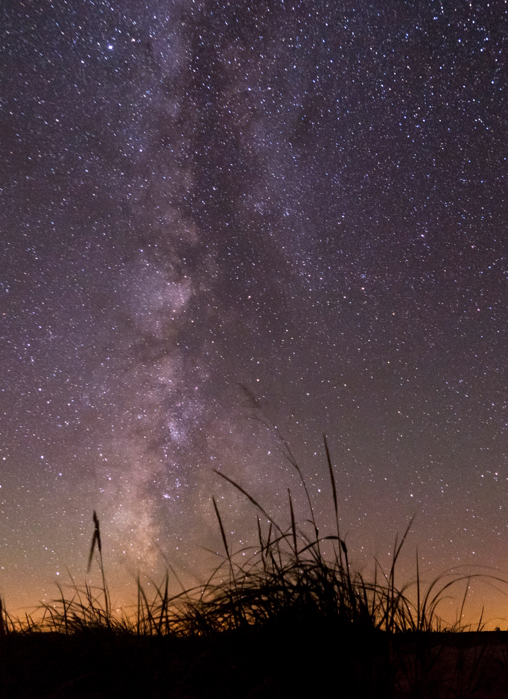
Incorporating Dark Sky Friendly Lighting Design into Community Planning Efforts
Outdoor lighting is needed for people to perform certain tasks in a safe manner, however, overly lit environments or improper use of lights at night can have negative consequences on the human environment.
“Without proper precautions, the addition of artificial light at night (ALAN) can change the natural night sky conditions and affect scenic, historic, cultural, scientific, recreational, and ecological resources and values that depend on darkness and dark night skies.”
- adapted from 2023 BLM Tech Note 457

Slide 14
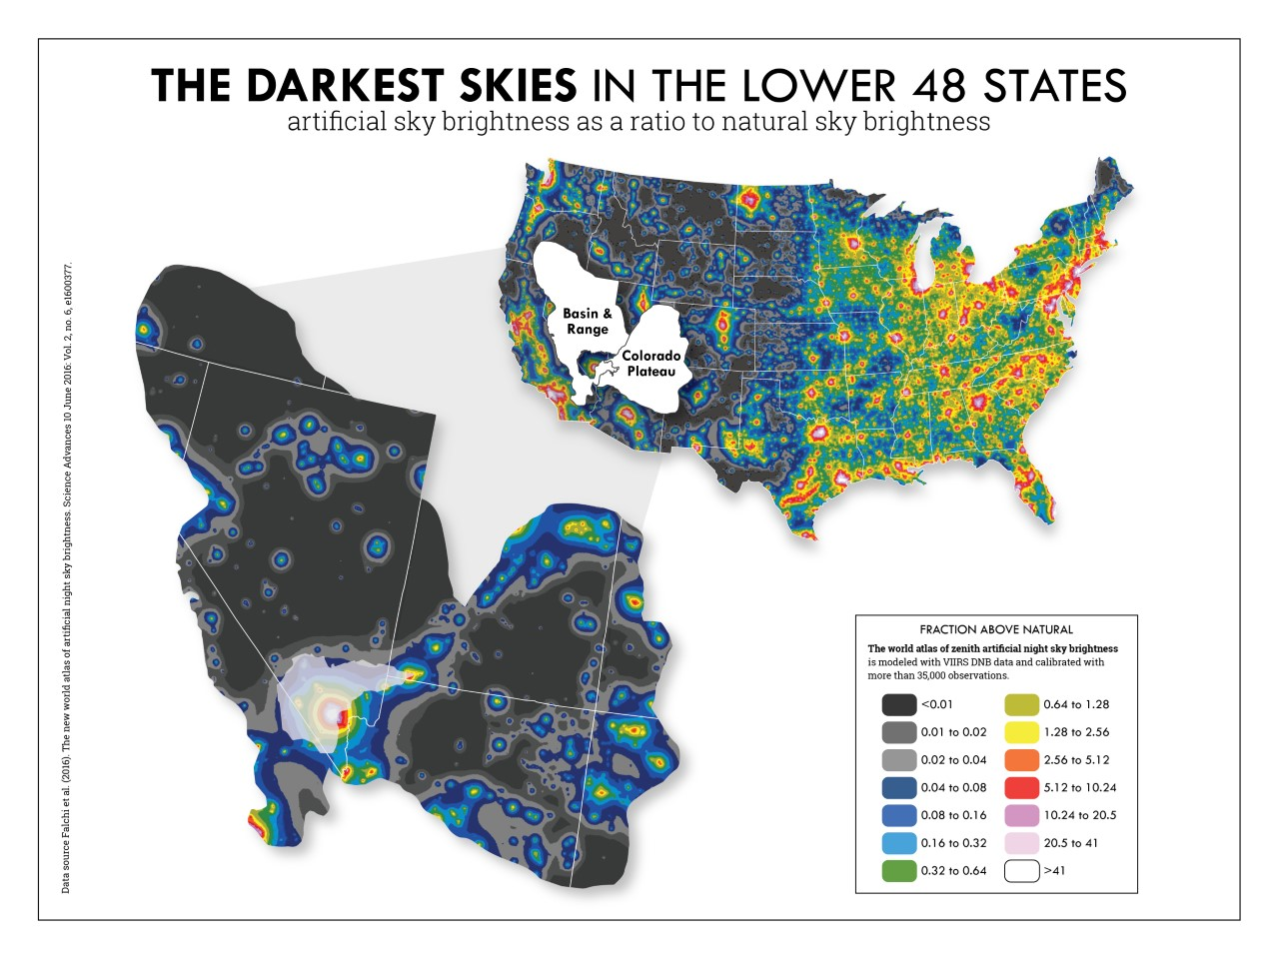
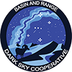
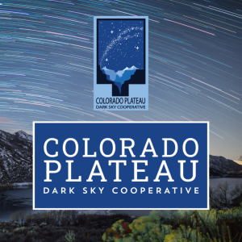
Working across the landscape is the most meaningful way to protect the night sky
Engaging with communities, non-profits, state, local, and federal agencies, tribes, universities and astronomical organizations
Notes:
Regional efforts.

Slide 15
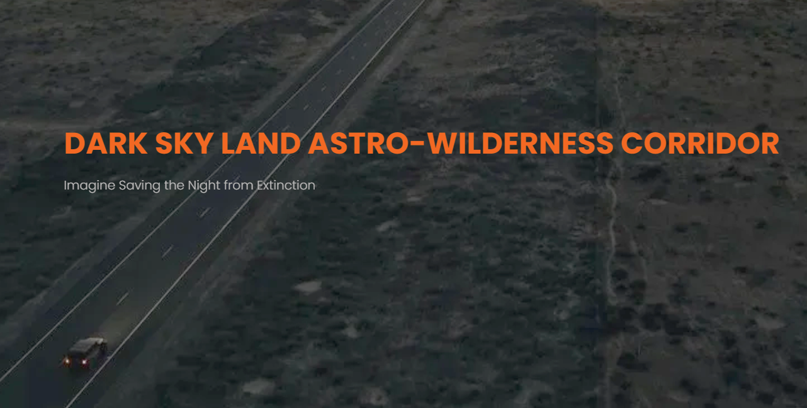
Dark Sky Initiatives in New Mexico
Ongoing efforts for more International Dark Sky Place certifications - Currently 9 in NM
DarkSkyLand – Astro Wilderness Corridor
Continental Divide Trail Coalition – Pie Town Dark Sky Annual Event
Cielo Centro – UNM-Taos
STEMarts Lab – Youth AstroTours, Space on Earth Podcast,- Taos Chapter, and much more!
Notes:
https://www.nmdarksky.org/darkskyplaces/nmdarkplaces.html
https://www.darkskyland.us/. SW New Mexico from Magdalena to Alma, NM. Follows Hwy 60 west to Route 32 south through Reserve. “Imagine Saving the Night from Extinction.”
https://taos.unm.edu/community/assets/cielo-centro-may-2024.pdf (presentation given to public in 2024). Would be the largest public accessible telescope in the SW, maybe the western US.
BLM partnering with STEMarts Lab for 2026 Star Parties and events, grant opportunities, night sky quality data collection, etc.
El Valle Astronomy Club

Slide 16
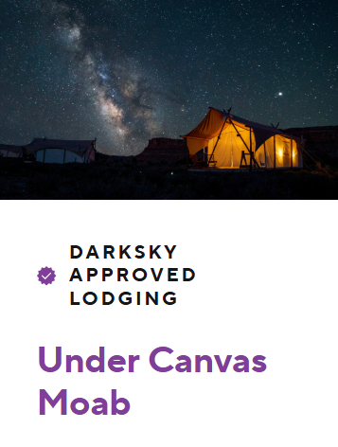
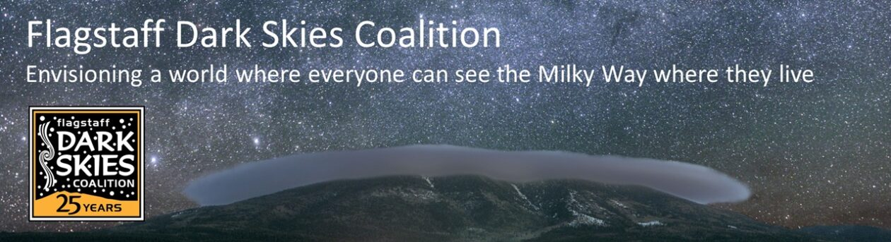
Dark Sky Place Certification
World’s first International Dark Sky Place - Community
230+ Dark Sky Places Certified
22 Countries and one Native Nation
Stargazer tents: windows for viewing the heavens
Astronomy hikes and talks
Telescope viewing
Notes:
Six categories of international dark sky place certification by DSI. Parks, Sanctuaries, Reserves, Urban Night Sky (SAGU), Communities, and Lodging.
Flagstaff became the world’s first International Dark Sky Community in the world in 2001. Flagstaff population approx. 77,500
Dark Sky Lodging is newest category inaugurated in 2023. Under Canvas Company has six dark sky approved lodging/resort locations in the US.
For more information on how to become dark sky place certified, please visit: Apply for Dark Sky Place certification | DarkSky International. Five different categories.

Slide 17
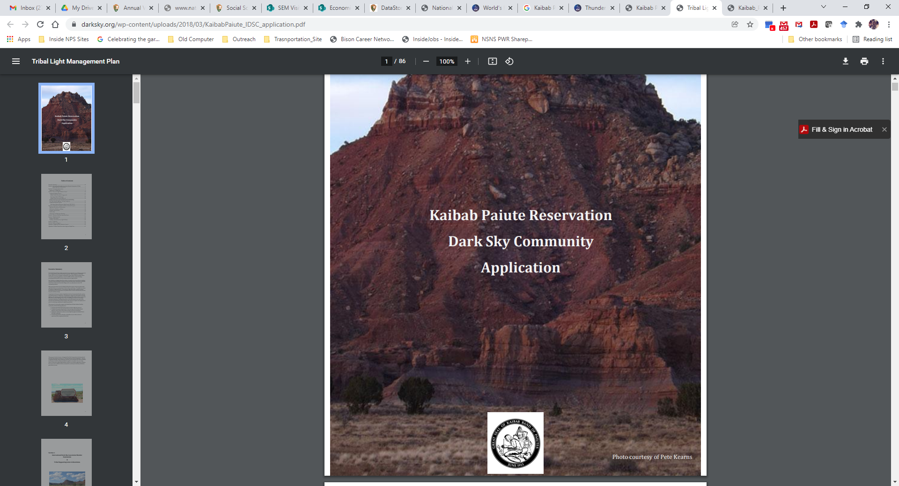
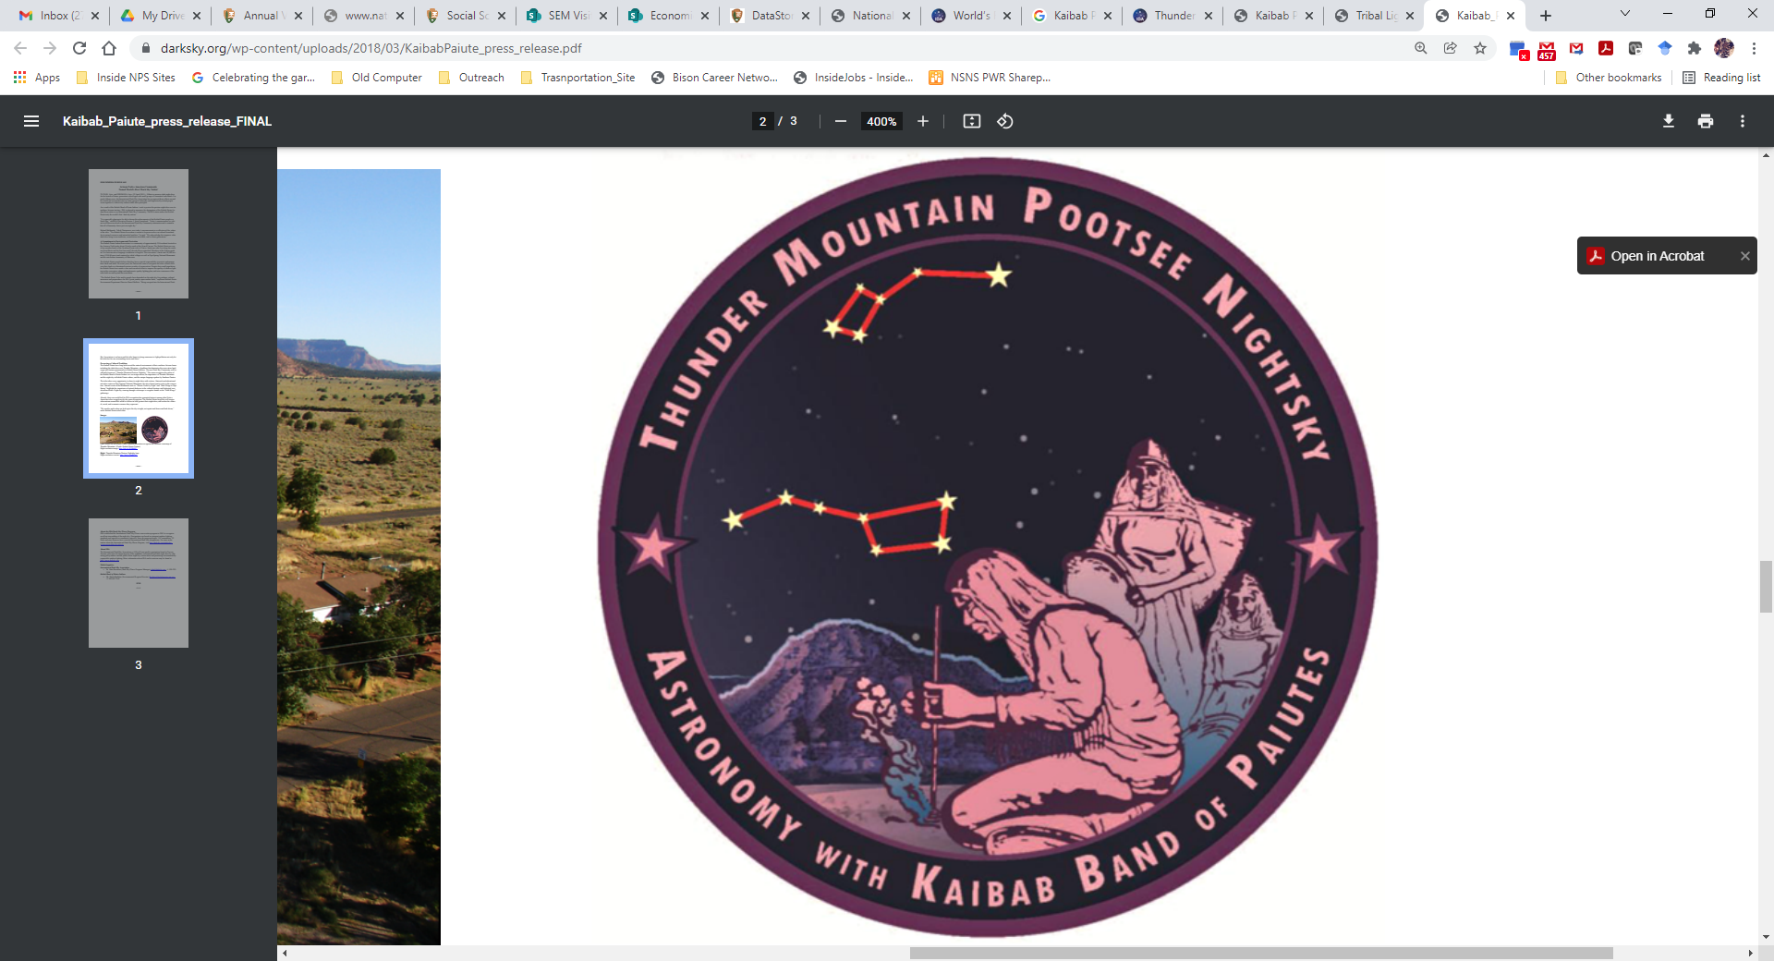
First Dark Sky Indian Nation
Dark Sky Certified Place in 2015
Kaibab Paiute
Thunder Mountain Pootsee Nightsky
Notes:
NPS managed Pipe Spring National Monument is within the Reservation boundary. PISP certified as dark sky park in 2021. https://www.nps.gov/pisp/learn/nature/lightscape.htm
The DSI Exec Director, Ruskin Hartley said: “This certification recognizes the exceptional quality of Pipe Spring’s night skies and their commitment to the cultural significance many of the native tribes in the region have for the night sky.”
Co-named Visitor Center (Pipe Spring National Monument - Kaibab Band of Paiute Indians Visitor Center and Museum)
Tribe and Monument partner to do night sky programming – they hire tribal members as park rangers
Per Daniel Bulletts: Cultural Re-Connect for tribal community: getting familiar again with their songs, dances and stories related to nights skies
For more information on how to become dark sky place certified, please visit: Apply for Dark Sky Place certification | DarkSky International. Five different categories.

Slide 18
Rio Grande del Norte National Monument
Application for Dark Sky Park Certification
APPLICATION
Process may take +/- two years
Collaborate with DSI (Main Office and NM Chapter) and other partners
Conduct night sky quality readings
Conduct lighting inventory
Lighting Plan – retrofits
No NEPA required; does NOT carry legal authority
BENEFITS
International recognition
Collaborate with other dark sky advocates in USA and world-wide
Use of DSI logo on BLM, Public Lands Interpretive Association (PLIA) materials
Opportunity to collaborate with Town of Taos, Taos County, Taos Pueblo, Village of Questa, UNM-Taos, Friends of RGdNNM, PLIA, and others to protect and restore night skies, engage in dark skies education and outreach efforts, and promote dark sky tourism opportunities.
Notes:
RGdNNM would be first Dark Sky Certified Place in NM managed by the BLM

Slide 19
Economic Value of Astro-Tourism
Economic value
In 2019, Mitchell and Gallaway reported that the Colorado Plateau alone expects Astro-tourists to spend $5.8 billion over the next 10 years.
Dark Sky Tourism – tourism that includes astro-tourism and other night dependent activities; star parties, astronomy festivals, full moon hikes, indigenous night sky storytelling, night sky inspired artist events (artist in residence), and more.
Condé Naste says Astro-tourism will be #1 travel trend in 2024!
Darksky International releases guiding principles for responsible astro-tourism, 2024
Protecting night skies can offer an economic advantage through the reduction in light pollution.
Astro-tourism – sustainable economic development opportunity worldwide – Under One Sky!
Notes:
Without the protection of the natural and cultural resource values of the night sky, the economic value becomes diminished.
However, you don’t have to be a certified dark sky place to protect the night sky and promote astro-tourism in your community.
The popularity of night sky dependent events and activities increases the need to protect dark night skies on our public lands and surrounding communities for present and future generations.

Slide 20
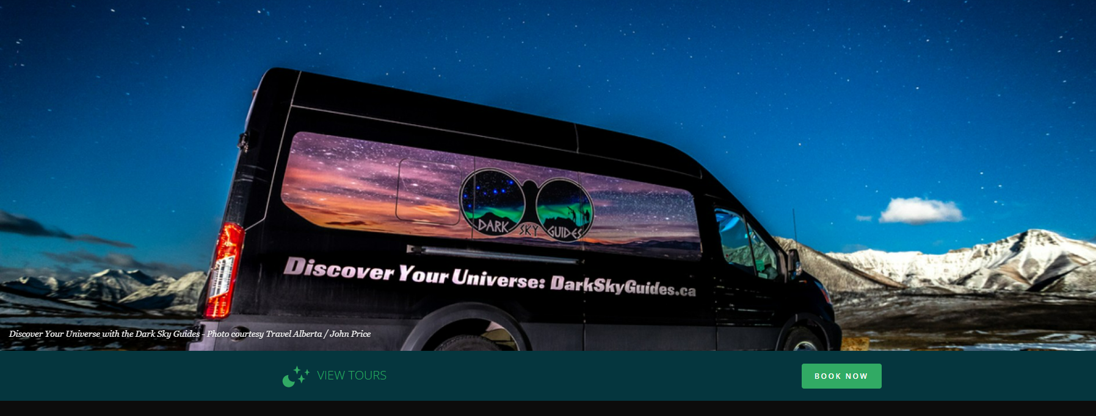
Tour Guides: Dark Sky Guides
Alberta, Canada
Notes:
Glacier National Park and Waterton Lakes National Park (Waterton-Glacier International Peace Park) - the only Transnational Dark Sky Park in the World!
https://www.heritageinspirations.com/taos-glamping-expedition-perseid-meteor-shower

Slide 21
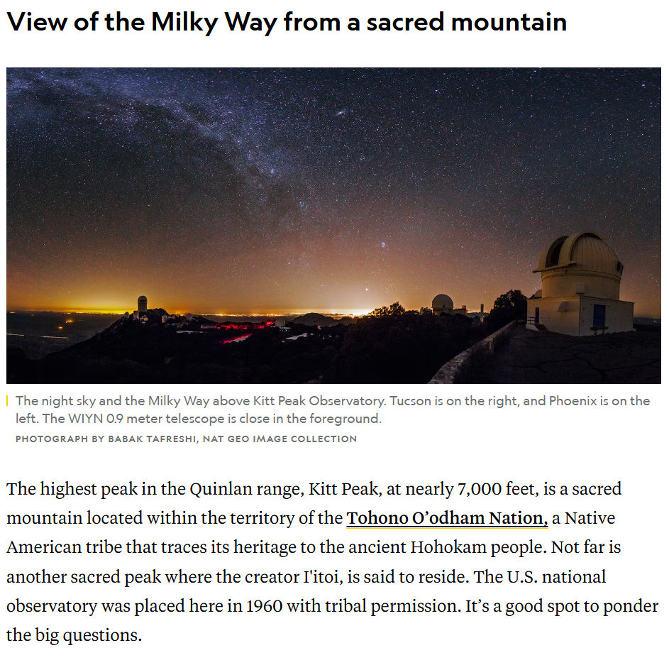
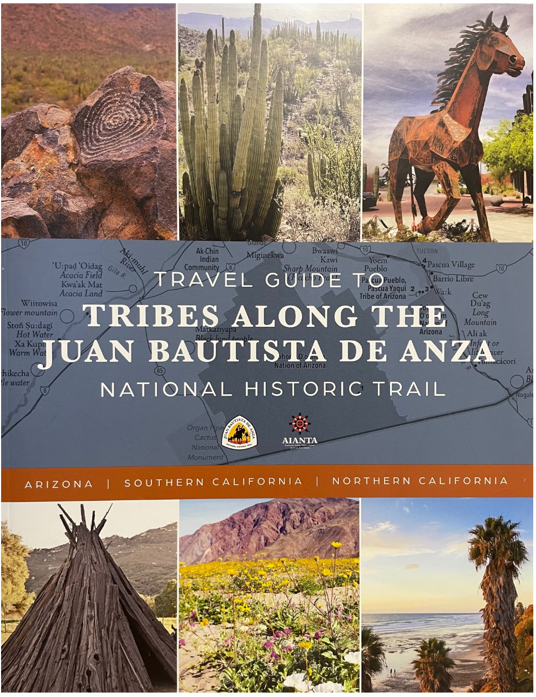
← National Geographic Article
Star Trail based out of Tucson, AZ. 2025
AIANTA and NPS Travel Guide to Tribes Along the Juan Bautista de Anza NHT, 2025.
https://www.nationalgeographic.com/travel/article/tucson-dark-sky-parks-astrotourism
Notes:
The city’s new Astro Trail—officially unveiled in January, 2025 —strings together 11 of the most visitor-friendly stops in a downloadable map.
Both the Astro Trail and Travel Guide have a common connection – Tucson. The city is within the travel guide route and the star trail route.

Slide 22
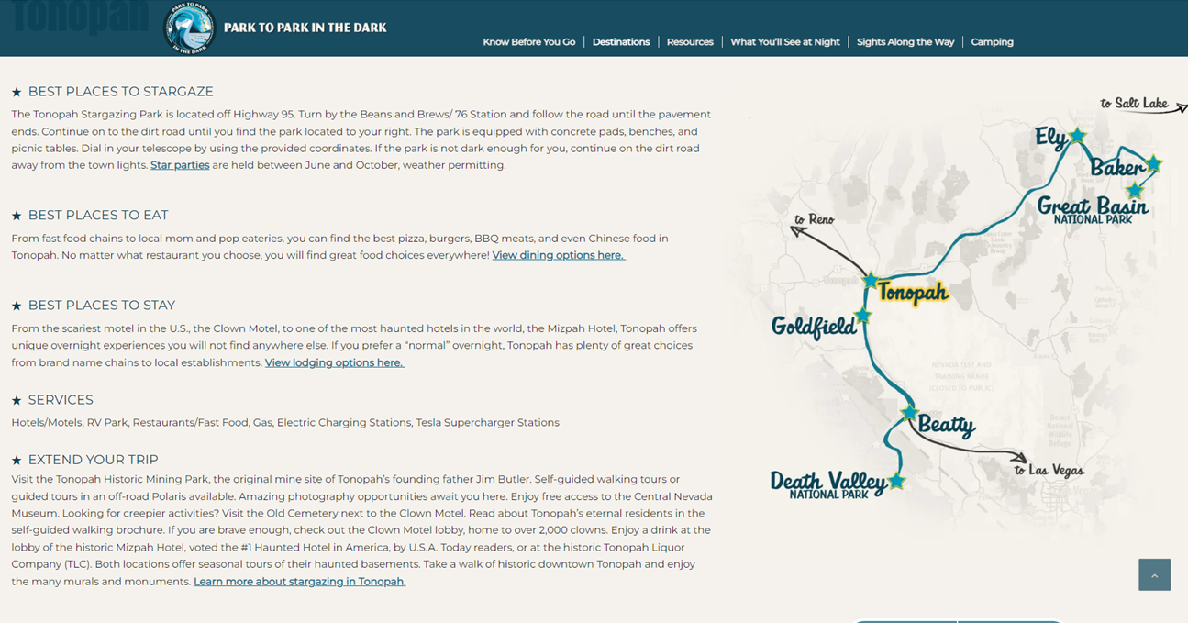
Dark Sky Road Trips
Nevada’s Park to Park in the Dark Route
Nevada is home to 28 Indigenous Tribes!
Dark Sky Tourism and Destination Tours
At least 6 Tribes with connections to area between DEVA and GRBA
Nevada’s Indian Territory – Opportunity to build in a dark skies tour
Duck Valley Shoshone-Paiute Tribe: Working towards development of first observatory on Tribal lands!
Notes:
The Park to Park in the Dark campaign is Nevada’s first astronomy route connecting two International Dark Sky Parks, Death Valley and Great Basin National Parks. It is touted as the Starry-est Route in America!
In 2024, 332 million park visitors spent an estimated $29 billion in local gateway regions while visiting National Park Service lands across the country, lodging was the highest directly affected sector with 11.1 billion in spending. These expenditures supported a total of 340,000 jobs, $18.8 billion in labor income, $33.7 billion in value added, and $56.3 billion in economic output in the national economy (NPS Visitor Spending Stats).

Slide 23
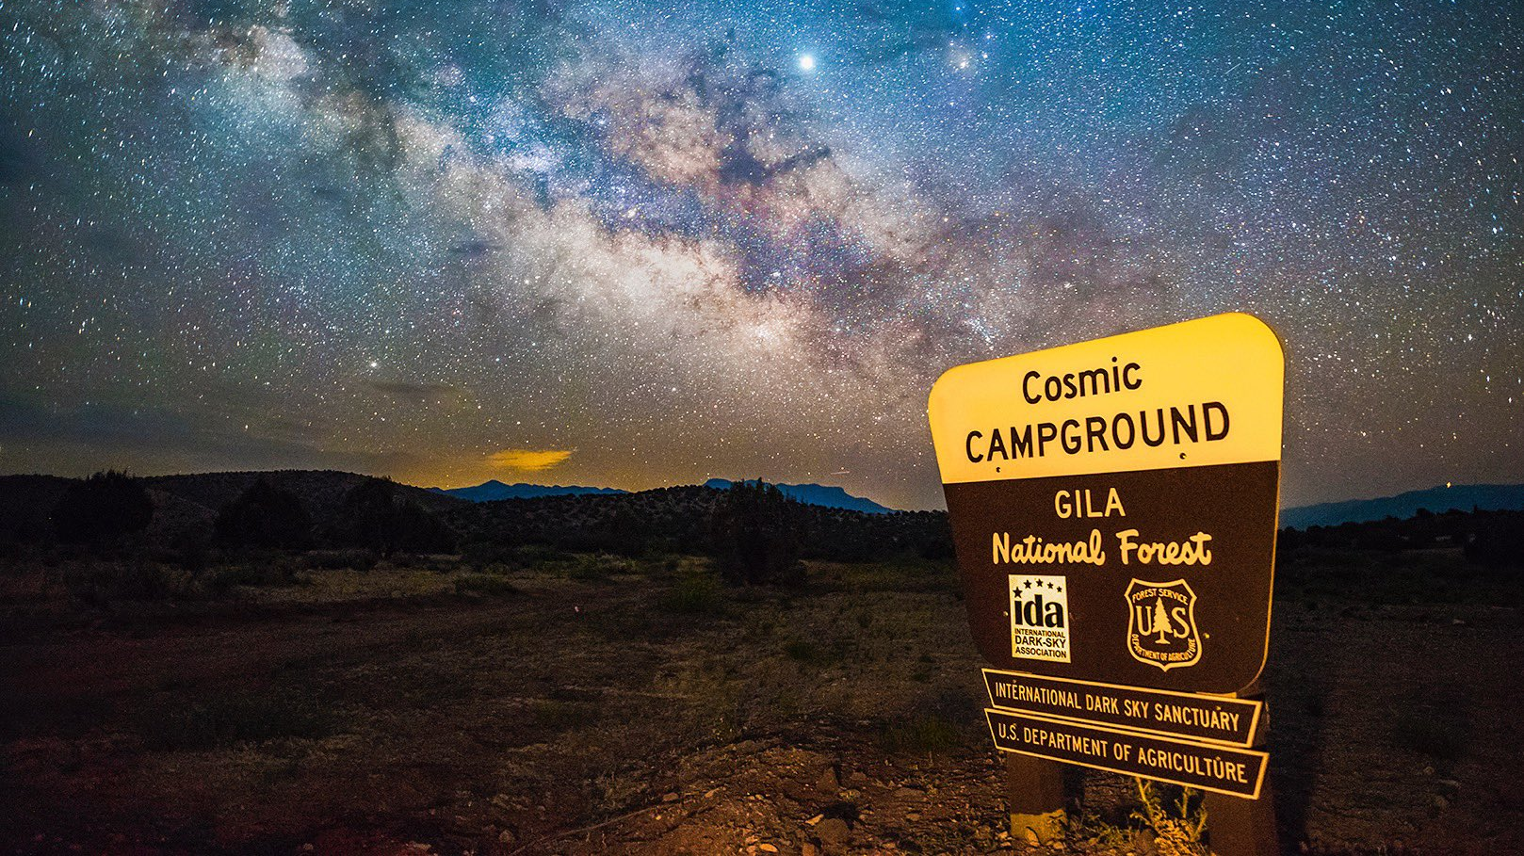
Campgrounds: Cosmic Campground
Include telescope pads
Night Sky Friendly Lighting
IDA Certified

Slide 24
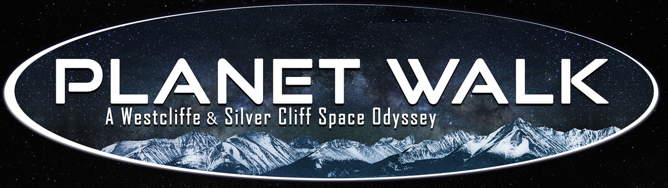
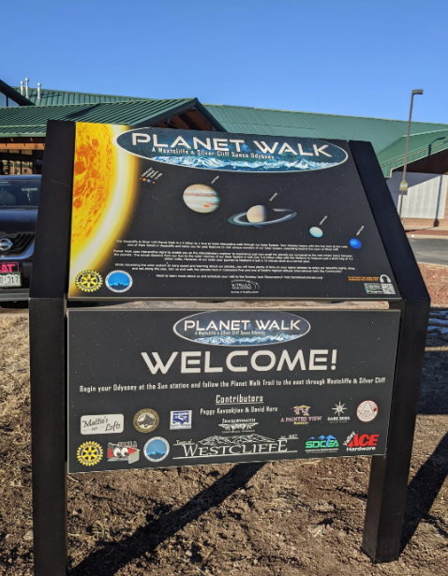
Collaborative effort
Interpretive signs
Interactive app
Follows main street
Population 750
Star Parties & Events
Observatory
Notes:
https://www.darkskiescolorado.org/ - darkskies.inc of the wet mountain valley
Westcliffe and Silver Cliff first certified dark sky community in CO
Outdoor lighting reimbursement program
Custer County Tourism Dark Skies web page
Stargazing lodging

Slide 25
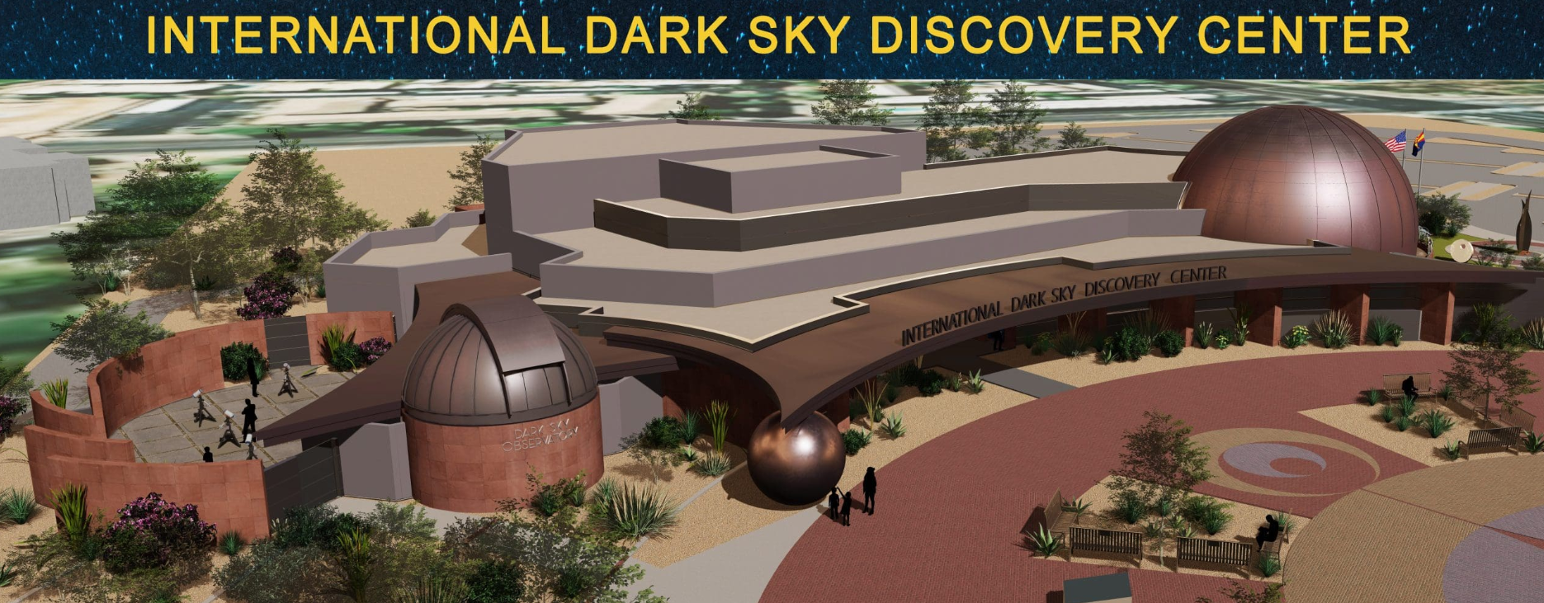
Human Health, Nocturnal Animals, and Dark Skies are Ours to Protect
Notes:
https://darkskycenter.org/
Opening 2026
International attraction in Fountain Hills, AZ
22,000 sq ft facility

Slide 26
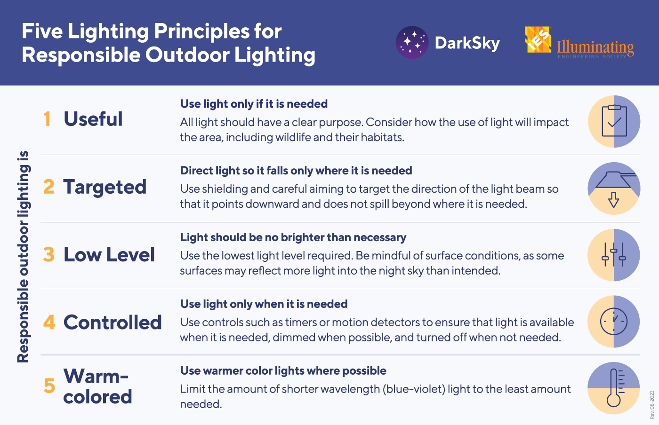
How do WE Keep Night Skies Dark?
Responsible Outdoor Lighting at Night - ROLAN

Slide 27
Select Resource Links
Cultural Connectedness to the Night Sky – Kaibab Band of Paiute Indians Interview
Dark Sky International New Mexico Chapter
Dark Sky International
NPS Night Skies – home page
Light Pollution Basics
Illuminating Engineering Society – develop standards for outdoor lighting
Design Lights Consortium - resources to reduce energy, carbon, and light pollution
Colorado Plateau Dark Sky Cooperative – search for Quarterly Connections Webinars
Basin and Range Dark Sky Cooperative
Publications on Night Sky Research
Dark Sky Place Certification Process
www.nativeskywatchers.com
Indigenous Education Institute - Sense of Place Webinar Series: Earth and Sky
DarkSky International: Guiding Principles for Responsible Astro-tourism
Flagstaff Dark Skies Coalition – First International Dark Sky City
Residential Lighting Products
Astro-tourism: From Astrophotography to Strategic Planning with Sergio Montúfar – YouTube Webinar
The Navajo Cosmos - International Dark Sky Week 2024 Presentation

Slide 28
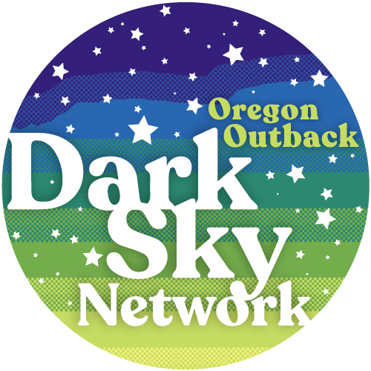
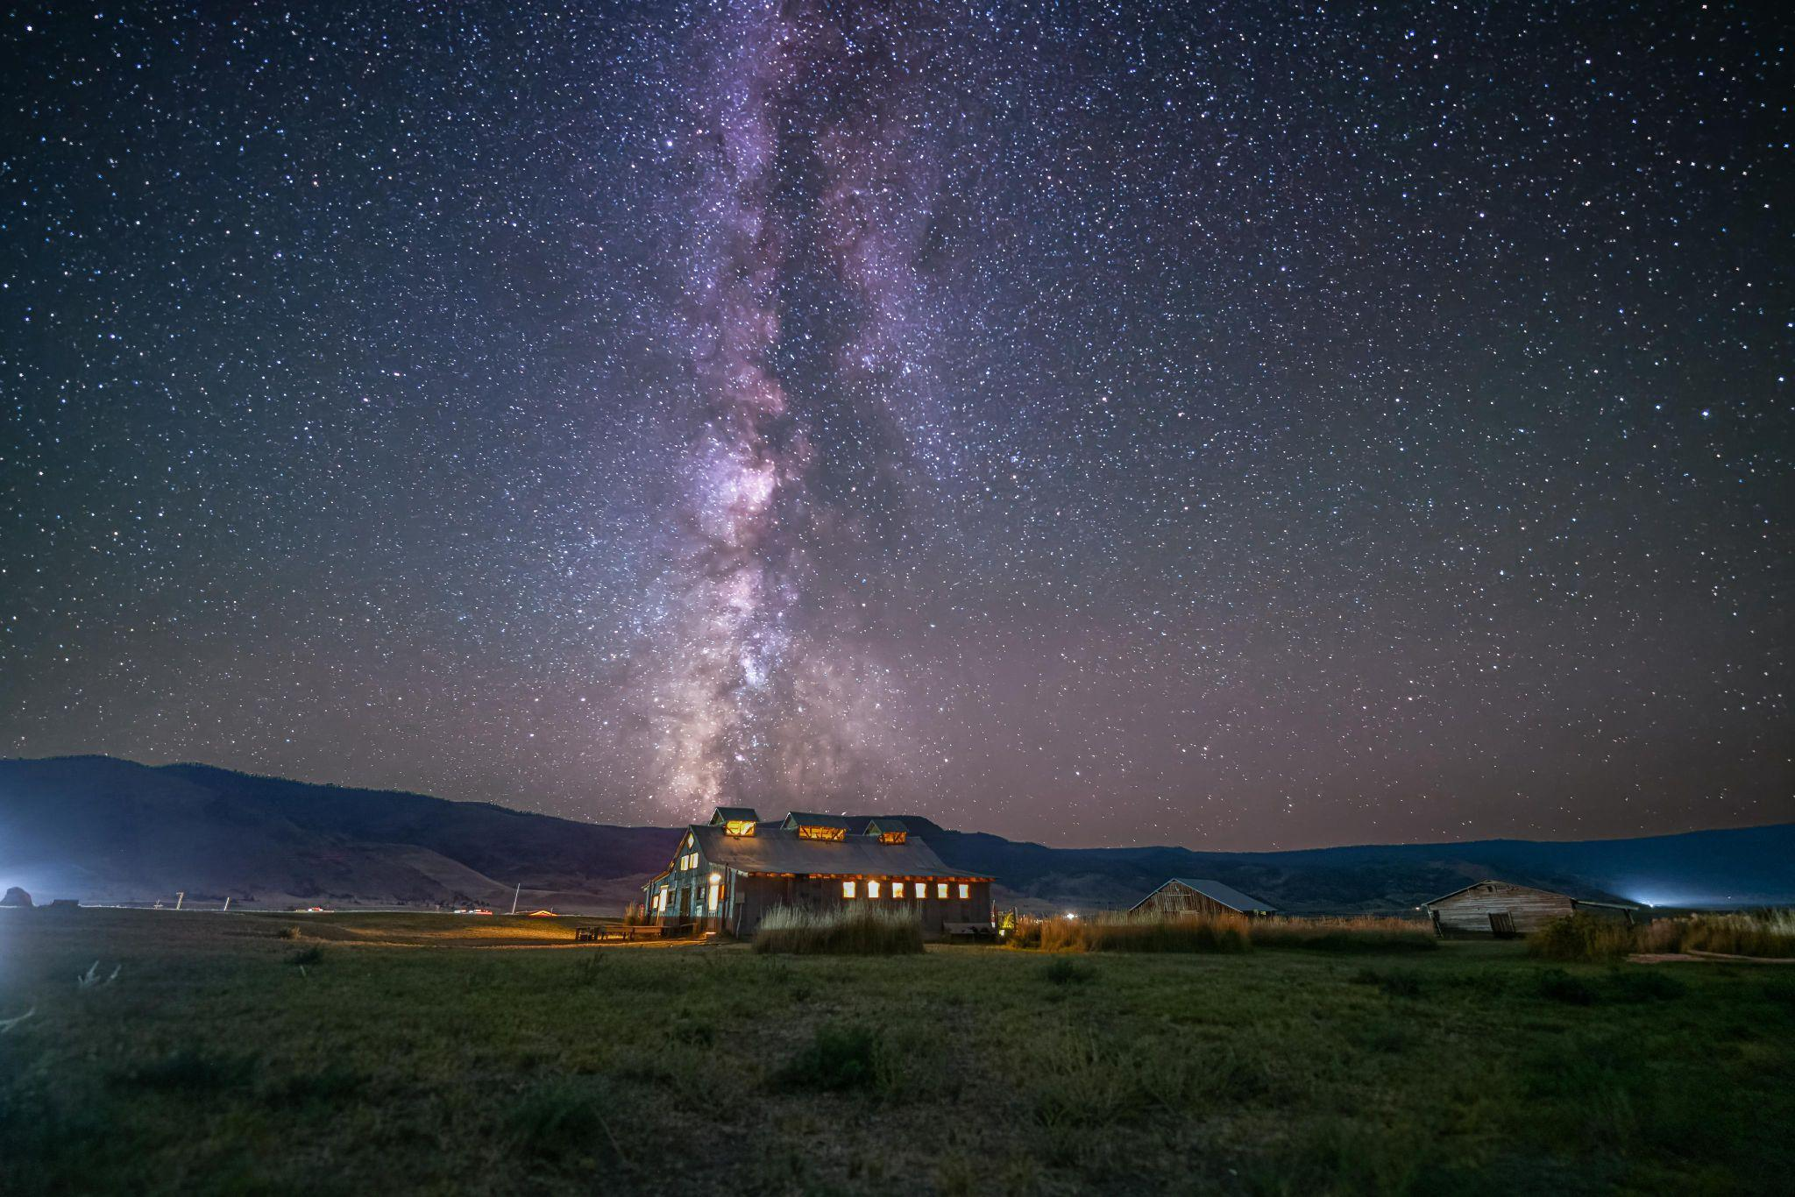
Celebrating Night Skies in the Oregon Outback
Bob Hackett
Executive Director

Slide 29

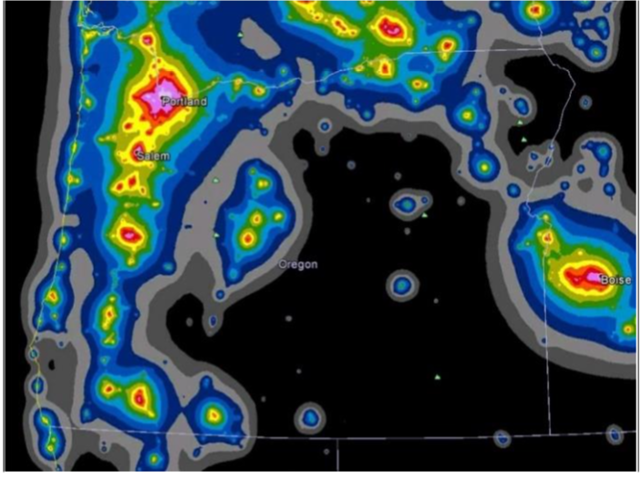
Oregon Outback Dark Sky Network
GOAL:
Landscape-scale project to celebrate and preserve our collective night-sky heritage in the Oregon Outback and create community-appropriate year-round recreational opportunities.
Oregon Outback
Dark Sky Sanctuary

Slide 30
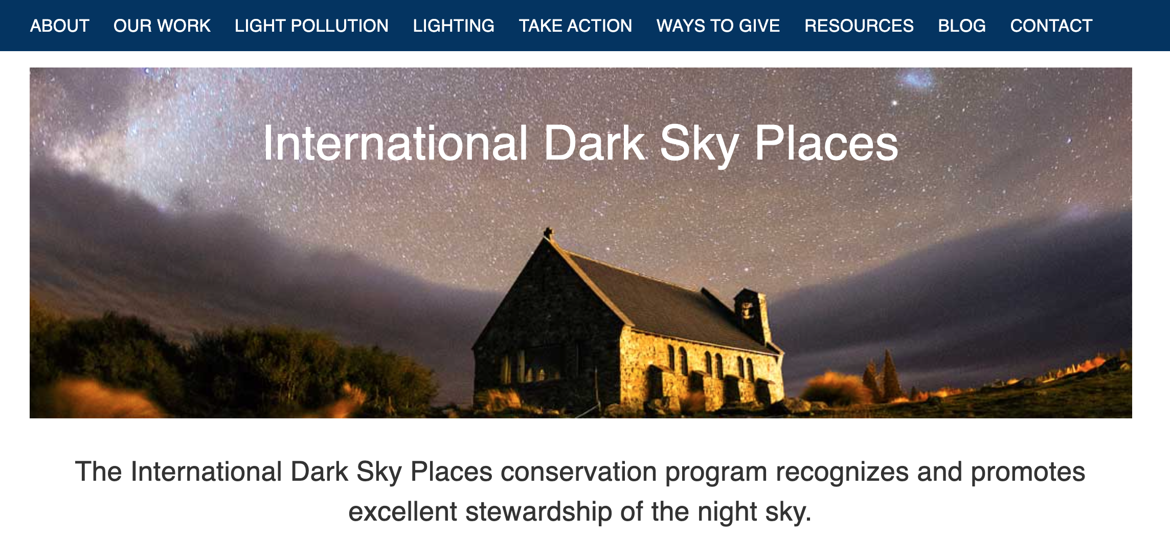
DarkSky International Dark Sky Places

Slide 31
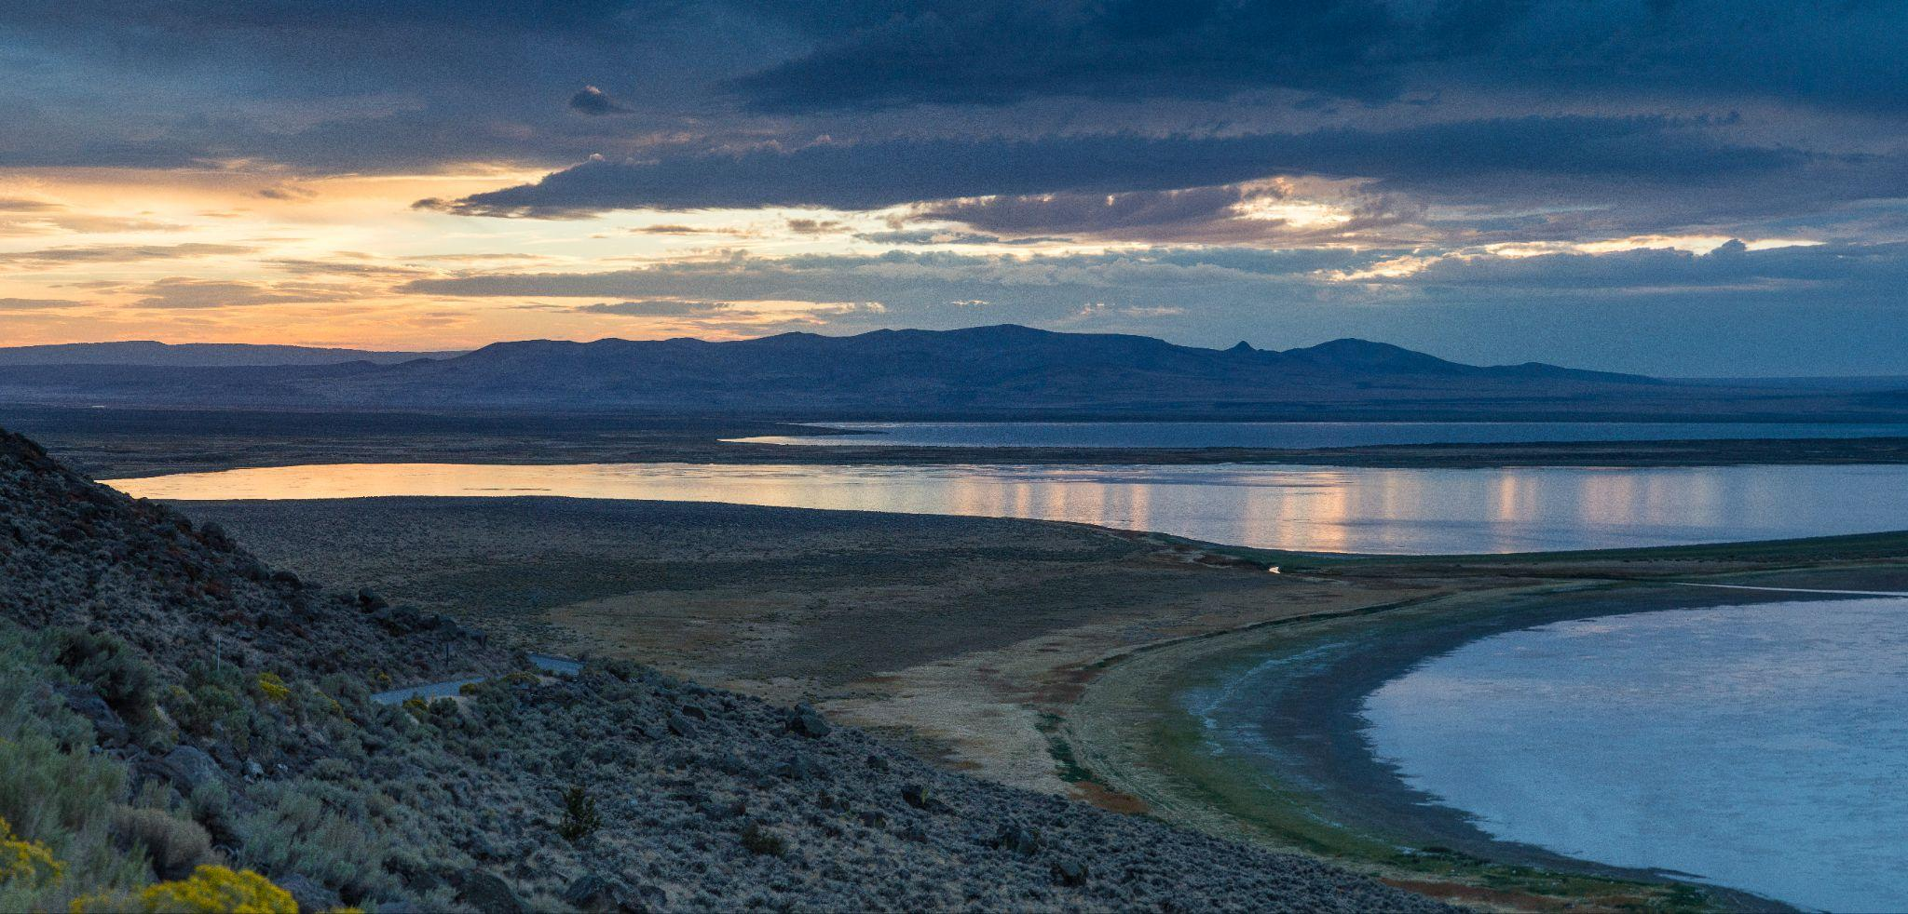

Slide 32
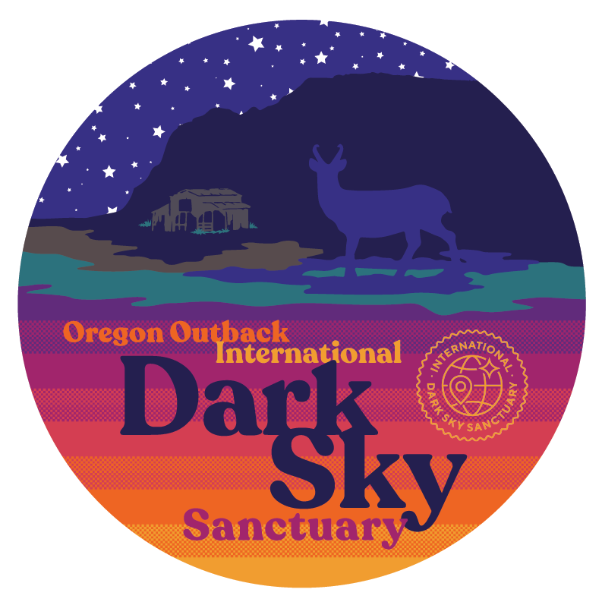
Oregon Outback International
Dark Sky Sanctuary
2.5 million acres in Lake County. Plans to further expand this protected area in phases are ongoing. (90% public, 10% private)
LMP Signatories:
Fremont-Winema National Forest (USFS)
Bureau of Land Management-Lakeview District (BLM)
U.S. Fish & Wildlife Service - Hart Mountain Antelope Refuge
Oregon Dept, of Transportation (ODOT)
Oregon Dept. of Fish & Wildlife (ODFW)
Oregon Dept. of State Lands (ODSL)
Oregon Parks & Recreation Dept. (OPRD)
Oregon Dept. of Aviation
Lake County Commissioners

Slide 33
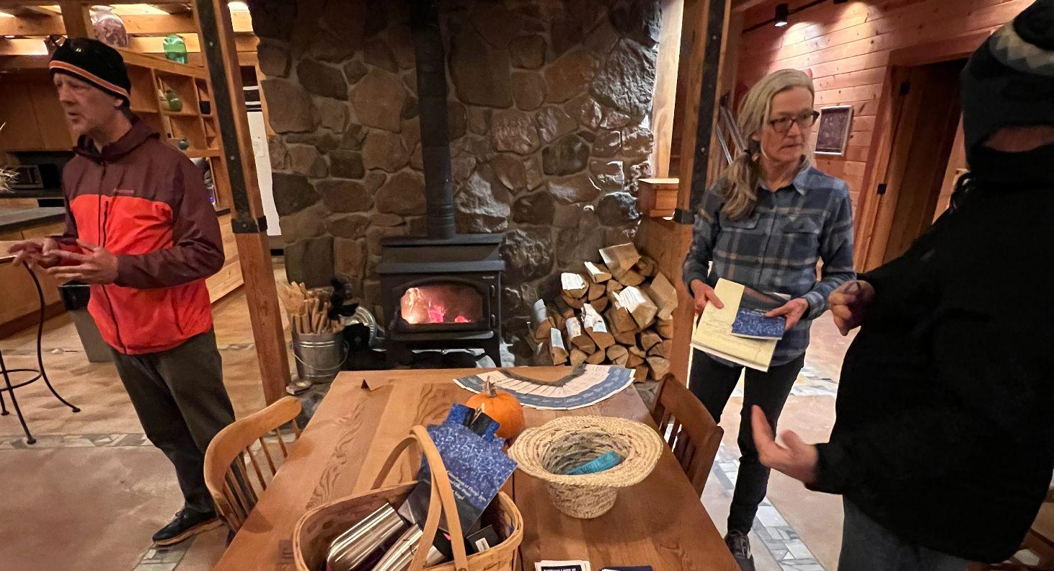
Partners - PLAYA Summer Lake

Slide 34
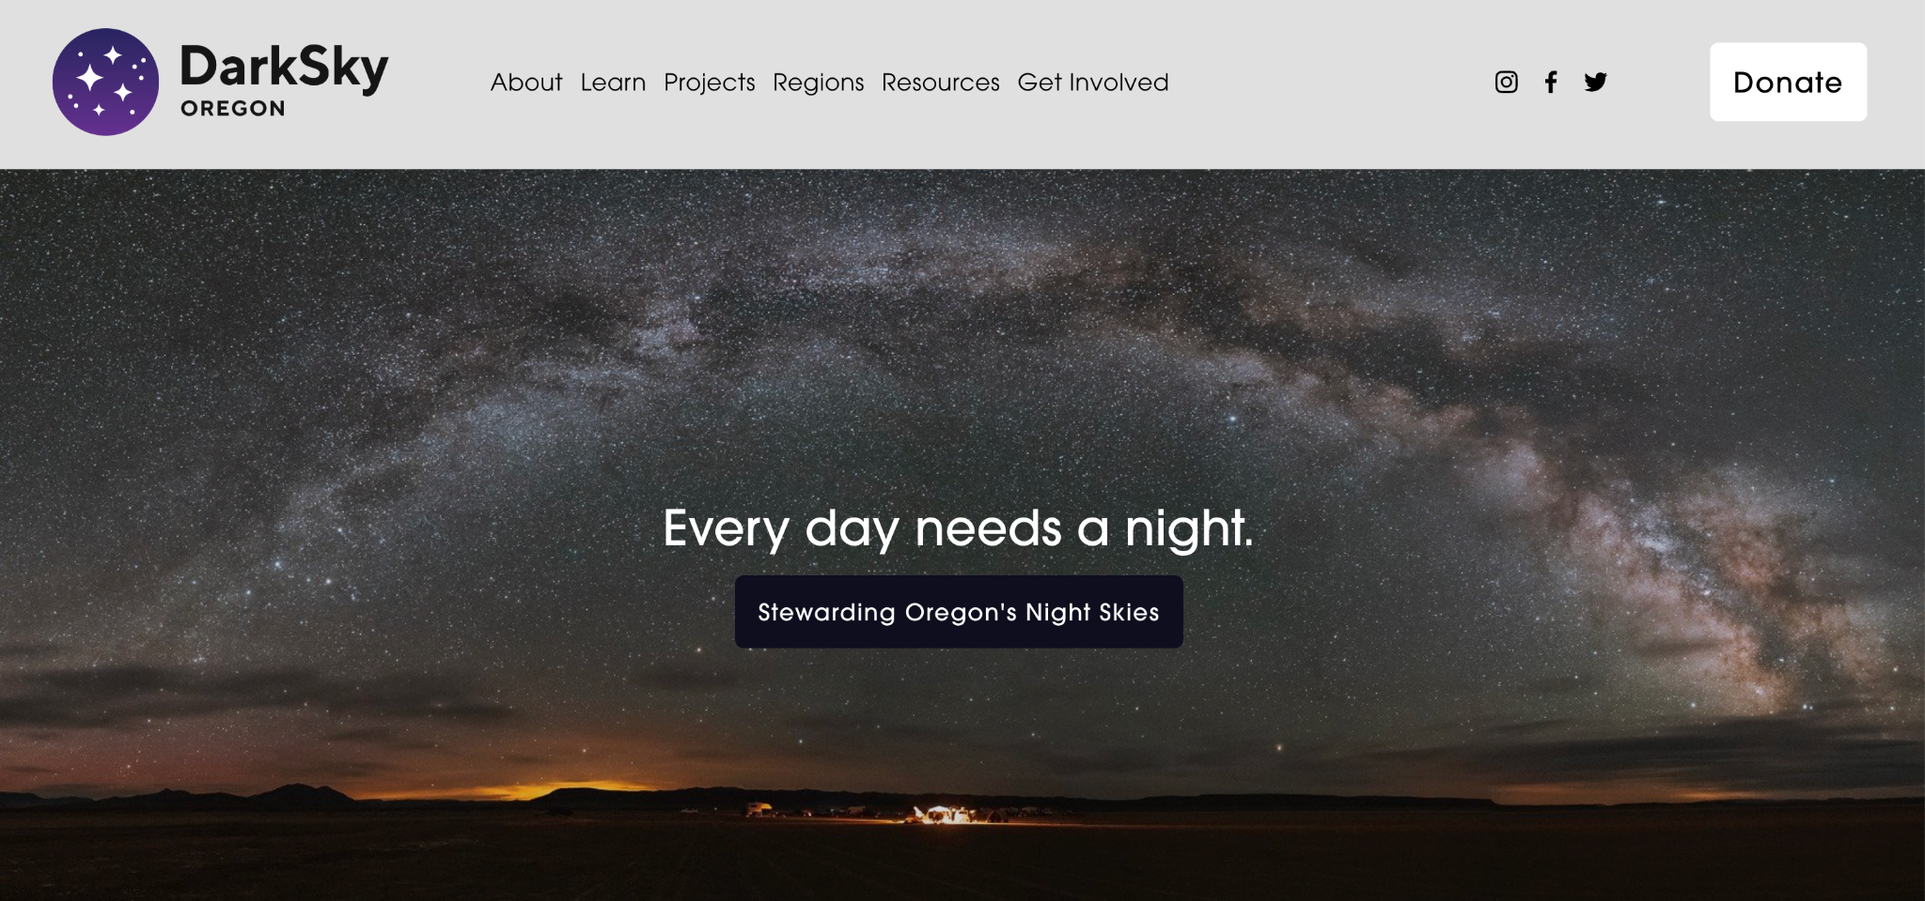
DarkSky Oregon

Slide 35
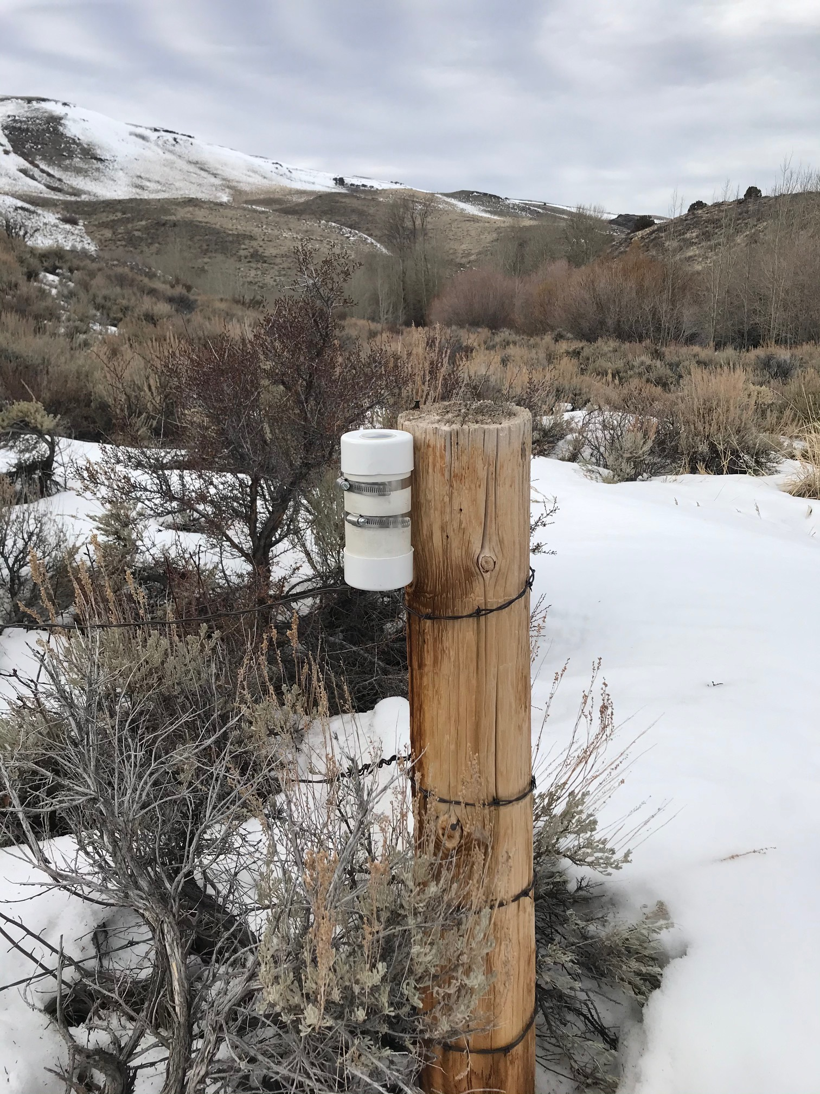
DarkSky Oregon - SQM Data Assist

Slide 36
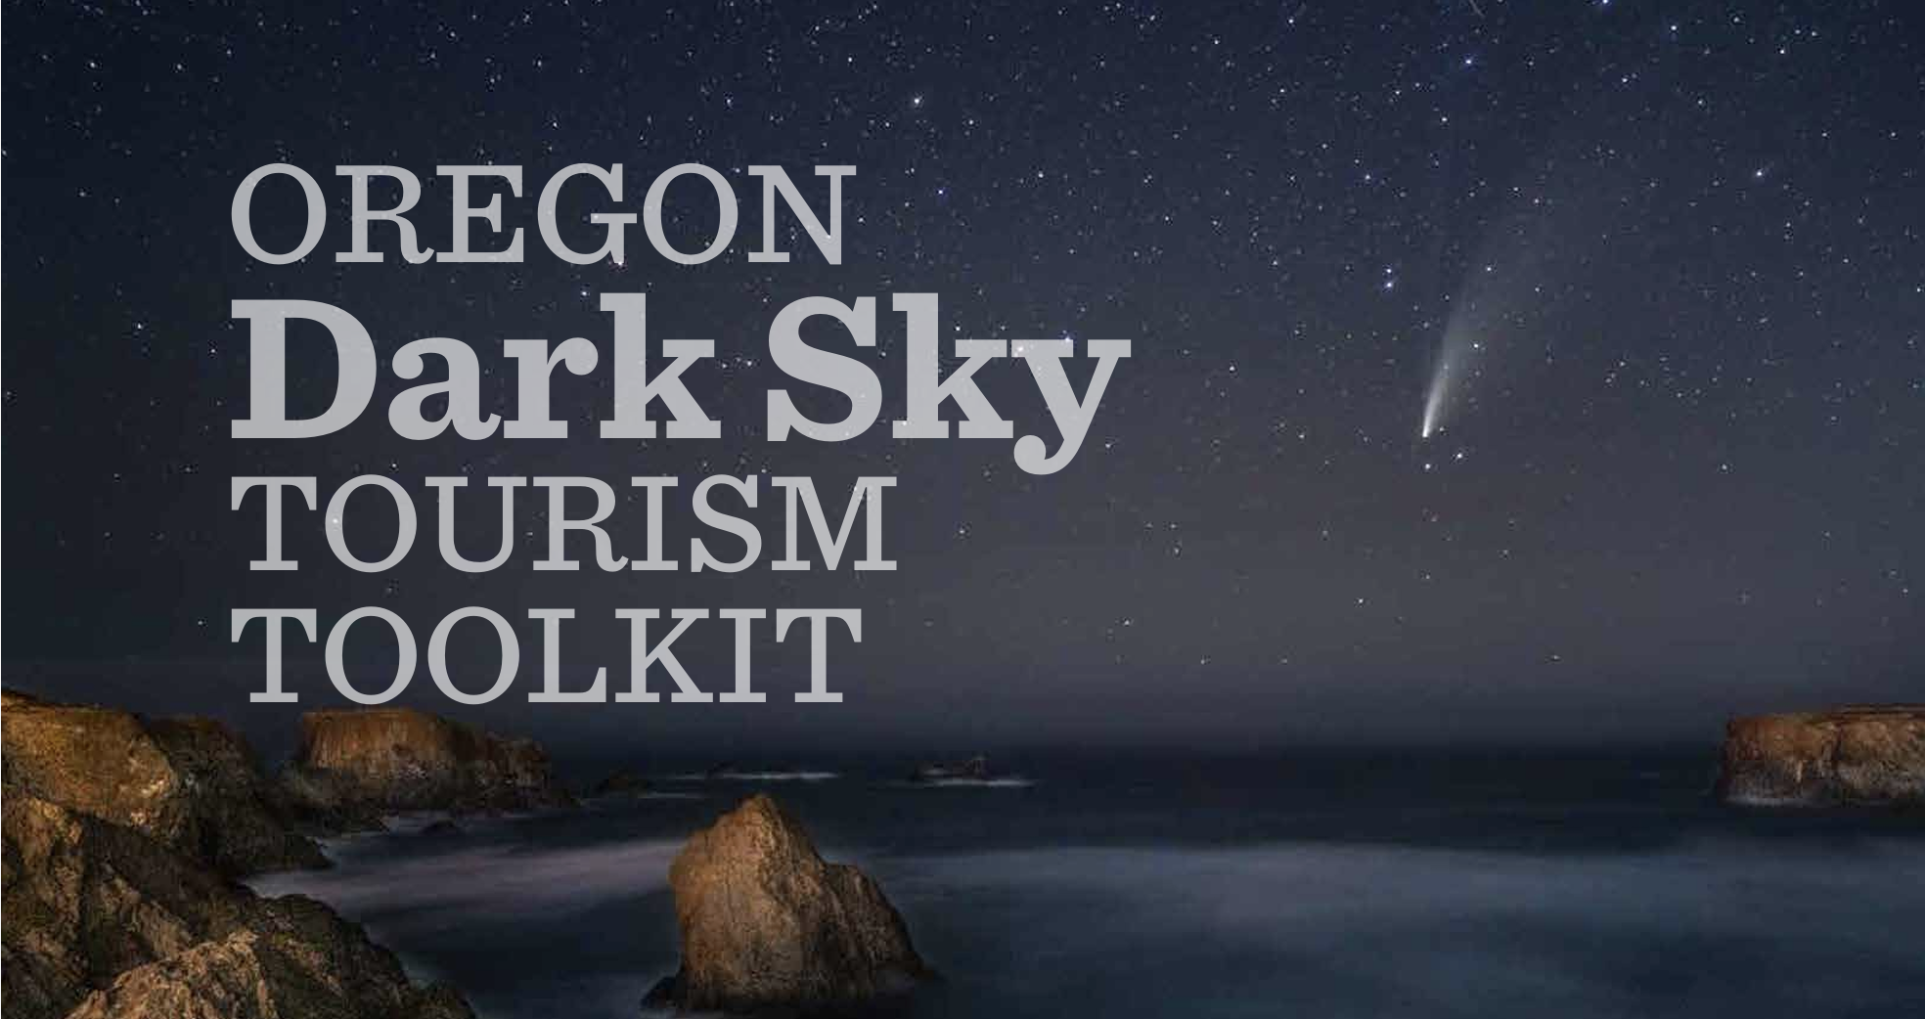
Travel Oregon

Slide 37
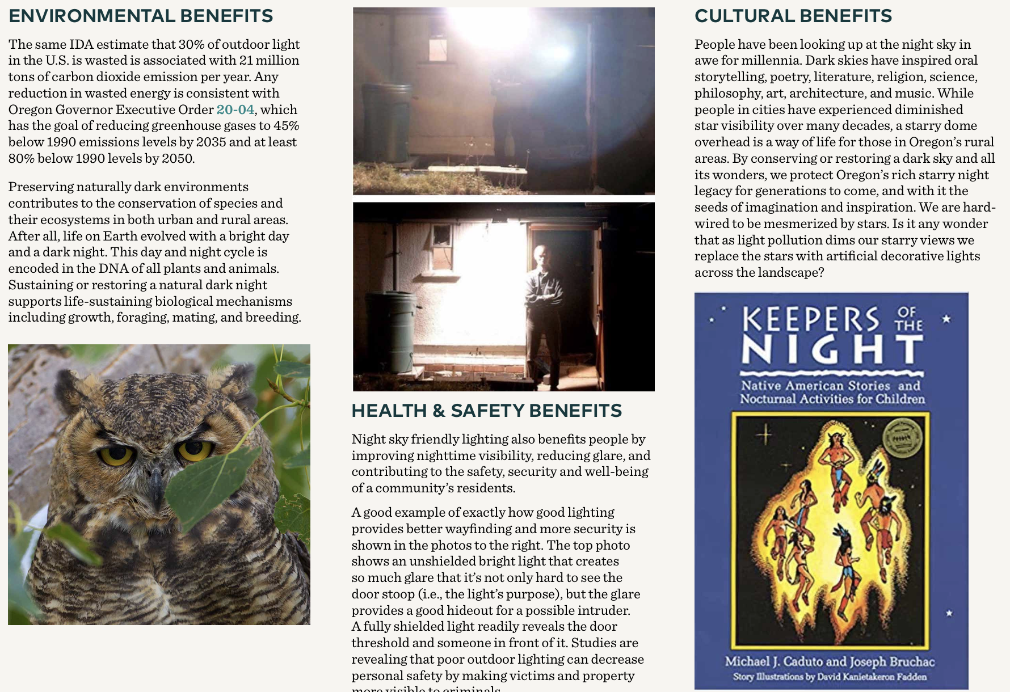
Travel Oregon

Slide 38
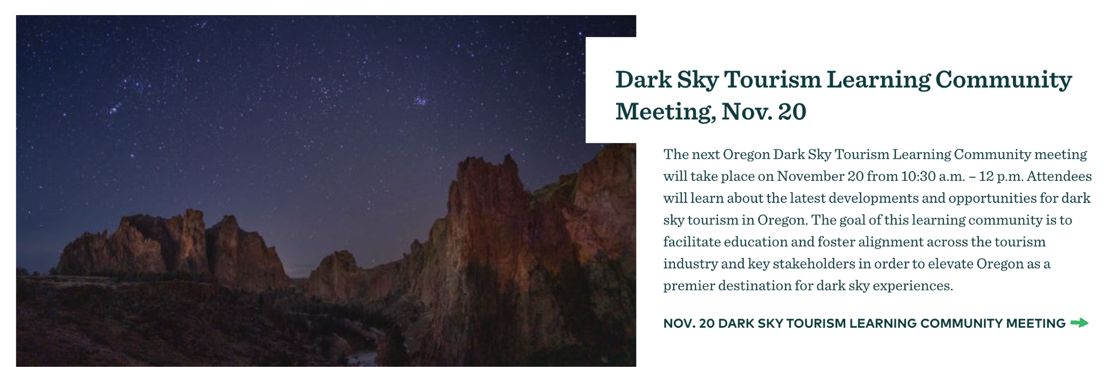
Travel Oregon

Slide 39
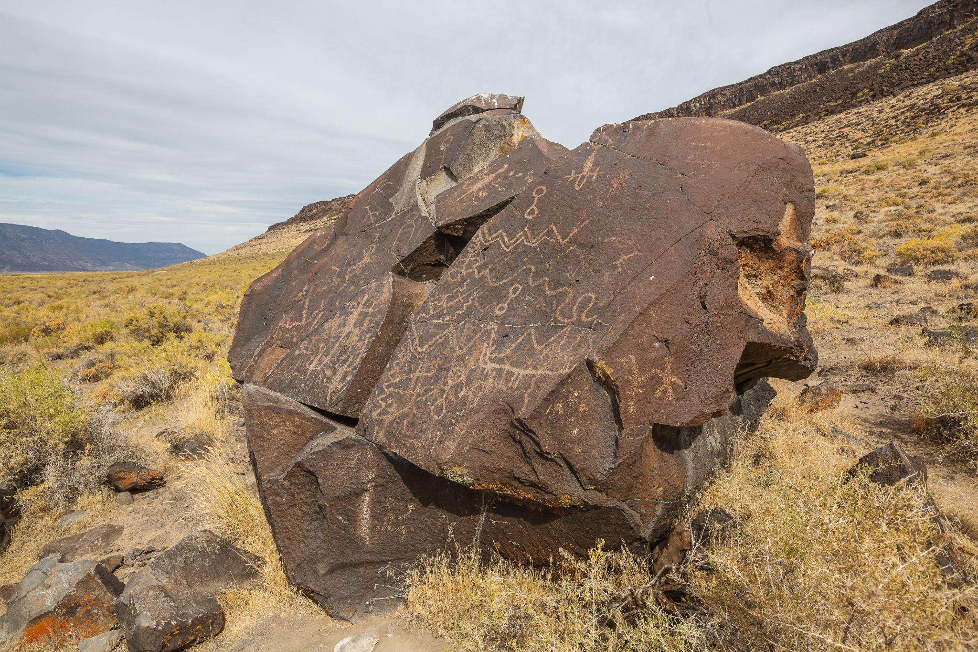

Slide 40
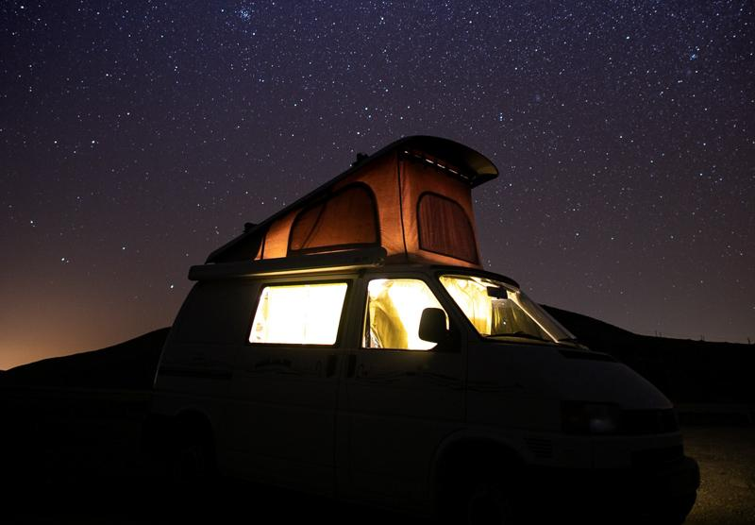
Why is Tourism at the Table?

Slide 41

Colorado Plateau 2019 Tourism Data

Slide 42

Visitor Messaging & Collaborations

Slide 43

BLM-Lakeview

Slide 44

BLM-Lakeview
Ongoing conversations with Klamath, Burns Pauite, and Fort Bidwell tribes
Messaging & History
Wildlife
Geology
Traditional Uses
Night Sky

Slide 45



Questions?

Slide 46




CIARRA GREENE
CIARRA GREENE
Visitor Outreach Manager, AIANTA
cgreene@aianta.org
Visitor Outreach Manager, AIANTA
cgreene@aianta.org
CIARRA GREENE
CIARRA GREENE
Visitor Outreach Manager, AIANTA
cgreene@aianta.org
Visitor Outreach Manager, AIANTA
cgreene@aianta.org
Notes:
Moderator: Good morning, all. Thank you for joining us today for AIANTA’s Webinar Series. Today’s webinar is in partnership with partners/funding source.
Moderator: I am Moderator Name, Title (introduce yourself).
For more than 25 years, the American Indian Alaska Native Tourism Association (AIANTA) has served as the only national organization dedicated to advancing cultural heritage tourism in Native Nations and communities across the United States. Established by tribes for tribes to address inequities in the tourism system, AIANTA is a 501(c)(3) national nonprofit governed by an all-Native board of directors and serves as a united voice for the $15.7 billion Native hospitality sector. AIANTA’s mission is to define, introduce, grow, and sustain American Indian, Alaska Native and Native Hawaiian (AIANNH) tourism that honors traditions and values while helping AIANNH businesses become market/export ready for domestic and international markets. Tribes who are looking to start or expand their cultural tourism footprint can find resources at www.aianta.org and visitors interested in learning more about Native culture can visit www.nativeamerica.travel.
This presentation will cover webinar description (1-2 sentences).
Today, our presenters will be…

Slide 47





RESOURCES & OPPORTUNITIES
NativeAmerica.Travel
Promoting and support tourism experiences related to Native American, Alaska Native, and Native Hawaiian cultures. The site serves as a resource for travelers interested in learning more about Indigenous communities, their cultures, history, and the unique destinations they offer.
www.NativeAmerica.Travel
Notes:
Slide 4 – Speaker Introductions – Headshots
Moderator: Our first presenter is Speaker – Title – Bio.
Our next speaker is Speaker – Title – Bio.
We also have with us today, Speaker – Title – Bio.
I will now pass it over to our presenters; If you have any questions, please place them in the chat or the Q&A and we’ll get to them at the end of the presentation.

Slide 48



RESOURCES & OPPORTUNITIES
Notes:
Slide 4 – Speaker Introductions – Headshots
Moderator: Our first presenter is Speaker – Title – Bio.
Our next speaker is Speaker – Title – Bio.
We also have with us today, Speaker – Title – Bio.
I will now pass it over to our presenters; If you have any questions, please place them in the chat or the Q&A and we’ll get to them at the end of the presentation.

Slide 49

SUPPORTING TOURISM AND HEALTHY LANDS
IN NATIVE NATIONS AND COMMUNITIES.
Notes:
START WEBINAR RECORDING and give it a couple of minutes for people to join in.

